Slide 1
Work Zone ITS
Module 8

Slide 2
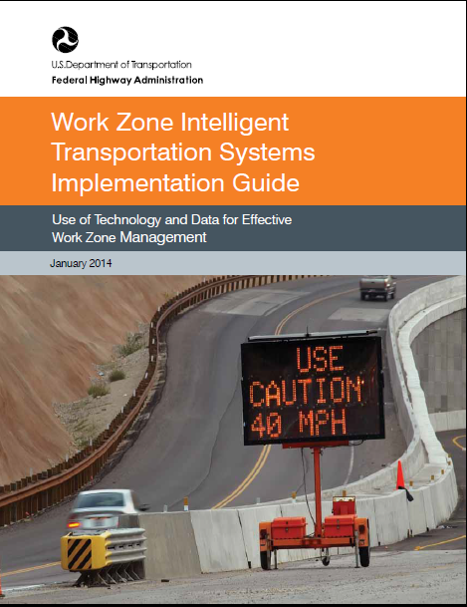
WZ ITS Implementation Guide
Recent guidance published by FHWA
Step by step process to improve results from the use of ITS
FHWA-HOP-014-008

Slide 3
Focus of the Guide
ITS is a tool to help meet work zone objectives regarding:
Safety
Mobility
Customer satisfaction
Work productivity and durability
Decisions as to feasibility/design/operation can follow a systems engineering problem-solving process

Slide 4
Guide Components
Implementation process
Key points
Tips

Slide 5
Guide Components (cont’d)
Key Takeaways
Examples

Slide 6
Implementation Process

Slide 7
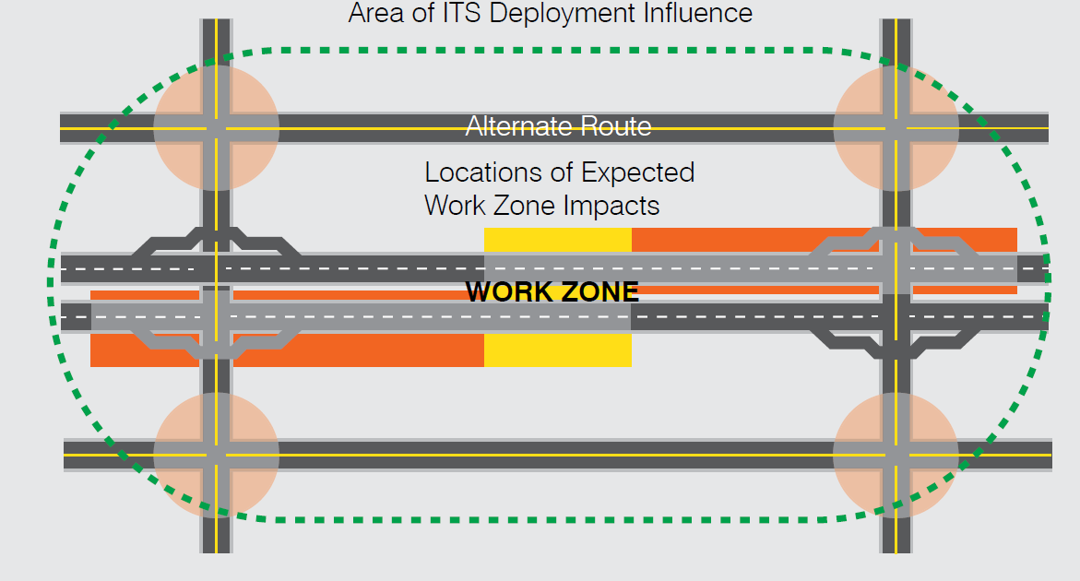
Step 1. Assessment of Need

Slide 8
Key Takeaways
Plan with the end in mind
Keep realistic expectations
Involve stakeholders early in the process
Incorporate as part of the Transportation Management Plan (TMP) development process

Slide 9
Step 2. Concept Development and Feasibility

Slide 10
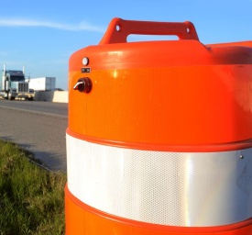
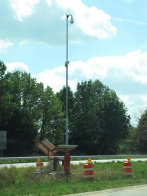
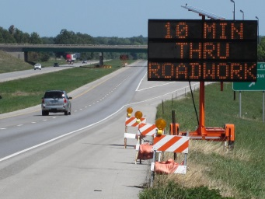
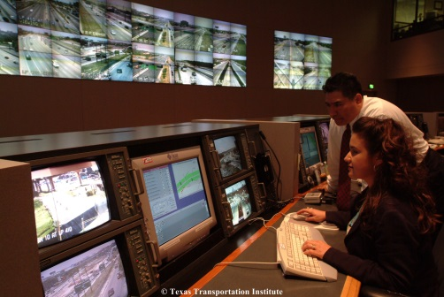
Categories of Work Zone ITS Solutions
Commercial off-the-shelf (COTS) systems
Customized work zone ITS
Procurement and use of work zone ITS data

Slide 11
Key Takeaways
Not all ITS deployments need to be complicated and expensive
Engage ITS staff expertise within the agency
Consensus-building within and across agencies is critical

Slide 12
Step 3. Detailed System Planning and Design

Slide 13
Step 4. Procurement

Slide 14
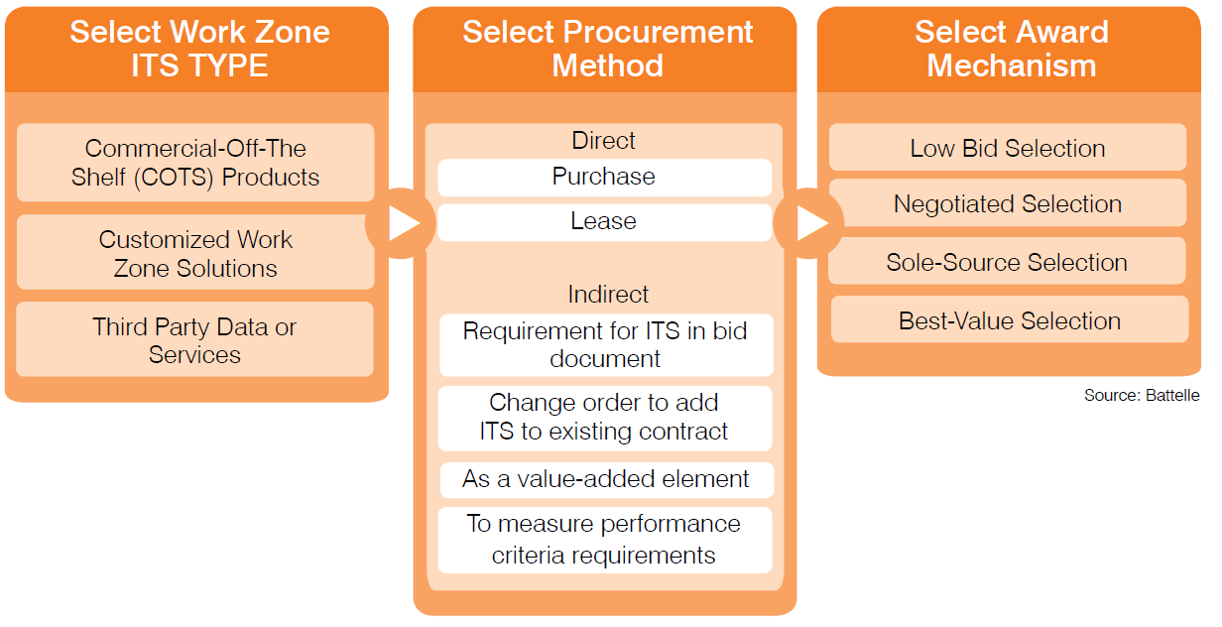

Slide 15
Key Tips and Takeaways
Work zone ITS need not conform to a traditional procurement approach; hybrid approaches are possible
Agency personnel experiences and capabilities with work zone ITS should be consulted before selecting procurement method
Including ITS procurement as part of initial contracting process is usually preferable to change-order additions
Procuring private-sector mobility data may be the simplest approach in certain cases, but the type of data procured should match overall system goals and objectives

Slide 16
Step 5. System Deployment

Slide 17
Key Tips and Takeaways
Allow for adequate start-up and calibration time
Significant resources may be required to remain on schedule; consider the potential for the unexpected to occur
New technologies may require longer testing times to achieve acceptable performance levels

Slide 18
Step 6. System Operation, Maintenance, and Evaluation

Slide 19
Key Tips and Takeaways
Flexibility is important; field conditions may differ significantly from what was expected in system planning and design
Managing expectations for the system continues to be important
Verification of information being disseminated to the public is critical
A final evaluation that identifies and documents key findings, lessons learned, etc. is a valuable learning tool for future efforts

Slide 20
VT Project – I91 Brattleboro

Slide 21
I91 Brattleboro
ASTI Transportation System - Contractor Controlled and Managed
SWZ equipment was used to determine traffic queues and delays, as well as, to gather data to predict traffic flow to decide to close the interstate ramp and detour traffic.
Especially useful data for ski holidays to determine how many vehicles would be exiting the highway.

Slide 22
VT Project – I91 Hartford

Slide 23
I91 Hartford
ASTI Transportation System - Contractor Control and Agency Mananged
SWZ equipment was used to communicate information to the traveling public when work activities changed on the construction site.
The system would trigger an alternate route to bypass the construction site when ramp traffic back-up, when setting the bridge girders, and during the closure itself.
Cameras were used to monitor work activity from afar by the public, legislators and VTrans.

Slide 24
VT Project – I89 Waterbury

Slide 25
I89 Waterbury
VER-MAC/ Jam Logic System - Agency Controlled and managed
SWZ equipment used to determine traffic queues and delays
Heat maps were developed from the collected data to develop useful traffic counts, average speeds and volume. This information was passed onto local law enforcement agencies.
Hotel/motel occupancy rates from bordering towns for large events and major weekend activities to aide in determining traffic control strategies for influxes of traffic.
Cameras aided in reviewing area of back-up from queuing traffic and incidents within the work zone.

Slide 26
Ted P. Nemsky, P.E. Illinois Department of Transportation
ITS Work Zone Analysis
for Southern Illinois Projects
District 8 Construction Engineer

Slide 27
http://thesouthern.com/news/local/article_d2ba9b7a-9090-11df-b22a-001cc4c002e0.html?mode=image
Notes:
But not in a good way. Not a very good headline. Seven vehicle multiple (2) fatality accident involving 4 semitrailers with 2 of the trucks carrying asphalt to the project that caused the queue. It was a section of rural interstate with numerous sags and crests.

Slide 28
*Courtesy Ver-Mac
Screen Shot of Logic
Notes:
Most include some logic and with such a number of decisions need to be made when setting up a system.
Priority Order of messages
Special Provision required to notify traffic of stopped conditions (<30mph) . Our system was set with 40 mph trigger.
When you want to have it suggest an alternate route

Slide 29
PTS – Prepare to Stop Hours for August
*Courtesy Ver-Mac
Notes:
Most software is capable of providing a considerable amount of data analysis of the system functions (e.g. Prepare to Stop)

Slide 30
Are Smart Work Zones worth the cost?
2012/2013 Contracts | Contract $ | SMZ $ | % Cost
I-55 Madison Co. | $18.4 million | $455,000 | 2.5%
I-70 Effingham (3 contracts) | $87.3 million | $2.5 million | 2.8%
I-57 Marion SPUD Interchange | $40.4 million | $576,500 | 1.4%
I57/64 Mount Vernon | $30.6 million | $1.1 million | 3.6%
Totals | $176.7 million | $4.6 million | 2.6%
Notes:
Here are the costs associated with the SWZ’s for each of the 4 projects we had going the past couple of years. It varies from 1.4% to 3.6% but average around 2.6% of total contract costs. We knew that the delay times seemed to provide the information we were looking for but as Engineers we must analyze to find out if it was worth this cost. It is difficult to put a price on what value motorist put on delay times but I figured we could look to see if the system accomplished its primary directive of reducing accidents.

Slide 31
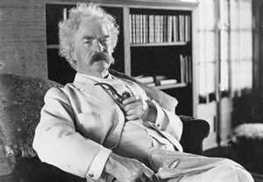
“Get your facts first, and then you can distort them as much
as you please. Facts are stubborn, but statistics are more
pliable.” - Mark Twain
http://www.bing.com/images/search?q=mark+twain+photos&qs=n&form=QBIR&pq=mark+twain+photos&sc=0-16&sp=-1&sk=
Notes:
This is a quote I like to remember whenever I am looking at statistics. I think it servers to try to keep me objective when analyzing such realizing as Mark Twain did that it is human nature to try to prove your point with statistics.

Slide 32
2010 & 2011
Seasons
Pavement Patching, Resurfacing
& Bridge Rehabilitation
$10.4 Million
CY 2010 & 2011
Rubblization and Resurfacing
$42.3 Million
CY 2011
Bridge Replacement and SPUD
Interchange Reconstruction
$23.5 Million
CY 2010 & 2011
Pavement Patching,
Resurfacing & Bridge
Rehabilitation
$9.6 Million
CY 2010
Pavement Patching,
Resurfacing & Bridge
Rehabilitation
$14.4 Million
CY 2010
Notes:
During the 2010/2011 Construction Seasons we had a considerable amount of work going on along I-55 near St. Louis.

Slide 33
2010 Season
Pavement Patching, Resurfacing
& Bridge Rehabilitation
$10.4 Million
ADT = 26,700
Smart Work Zone not utilized during 2010
Bridge Replacement and SPUD
Interchange Reconstruction
$23.5 Million
ADT = 36,500
Pavement Patching,
Resurfacing & Bridge
Rehabilitation
$9.6 Million
ADT = 39,700
Pavement Patching,
Resurfacing & Bridge
Rehabilitation
$14.4 Million
ADT = 35,550
Notes:
In 2010 these 4 jobs were on-going and a SWZ was not utilized.

Slide 34
2011 Season
Pavement Patching, Resurfacing
& Bridge Rehabilitation
$10.4 Million
ADT = 26,700
Rubblization and Resurfacing
$42.3 Million
ADT = 27,300
Bridge Replacement and SPUD
Interchange Reconstruction
$23.5 Million
ADT = 36,500
Smart Work Zone utilized on
all 3 contracts in 2011
Notes:
In 2011 these 3 jobs were on-going but with a SWZ in place as described earlier. Seemed like a great place to start was to compare the accident data between these 2 years for this route.

Slide 35
2011 Accident Data (Facts)
Notes:
So that is what I did. I summarized all rear end type accidents from our 2010 and 2011 accident data to analyze. Only looked at Rear End Accidents because those are what our system was set-up to reduce.

Slide 36
Notes:
Totaled statistics from each year.

Slide 37
2011 Construction Compared to 2010 (Statistics)
 | 2010 | 2011 | Difference | % Change
Total Miles I-55 Construction | 19.5 | 20.2 | +0.7 | +3.6%
Total Lane Closure Days | 355 | 540 | +185 | +52%
*Total Vehicle Exposure (ADT x Lane Closure Days) | 13,031,750 | 16,346,800 | +3,315,050 | +25.4%
Property Damage Accidents | 75 | 64 | -11 | -14.6%
Injury Accidents | 18 | 16 | -2 | -11%
Fatalities | 1 | 1 | 0 | 0%
Total Queuing Accidents | 94 | 81 | -13 | -13.8%
*Does not account for ADT using Detours
Notes:
And here are the results.
From 2010 to 2011 we had – go thru Comparison with following notes:
More lane closure days than in one year because a lane restriction was counted for each new set up through each work zone.
I decided to use Total Vehicle Exposure (ADT x Lane Closure Days) as a way to get closer to comparing apples to apples.
So in summary with over 25% more vehicle exposure rear end type accidents were reduced by nearly 14%

