Slide 1
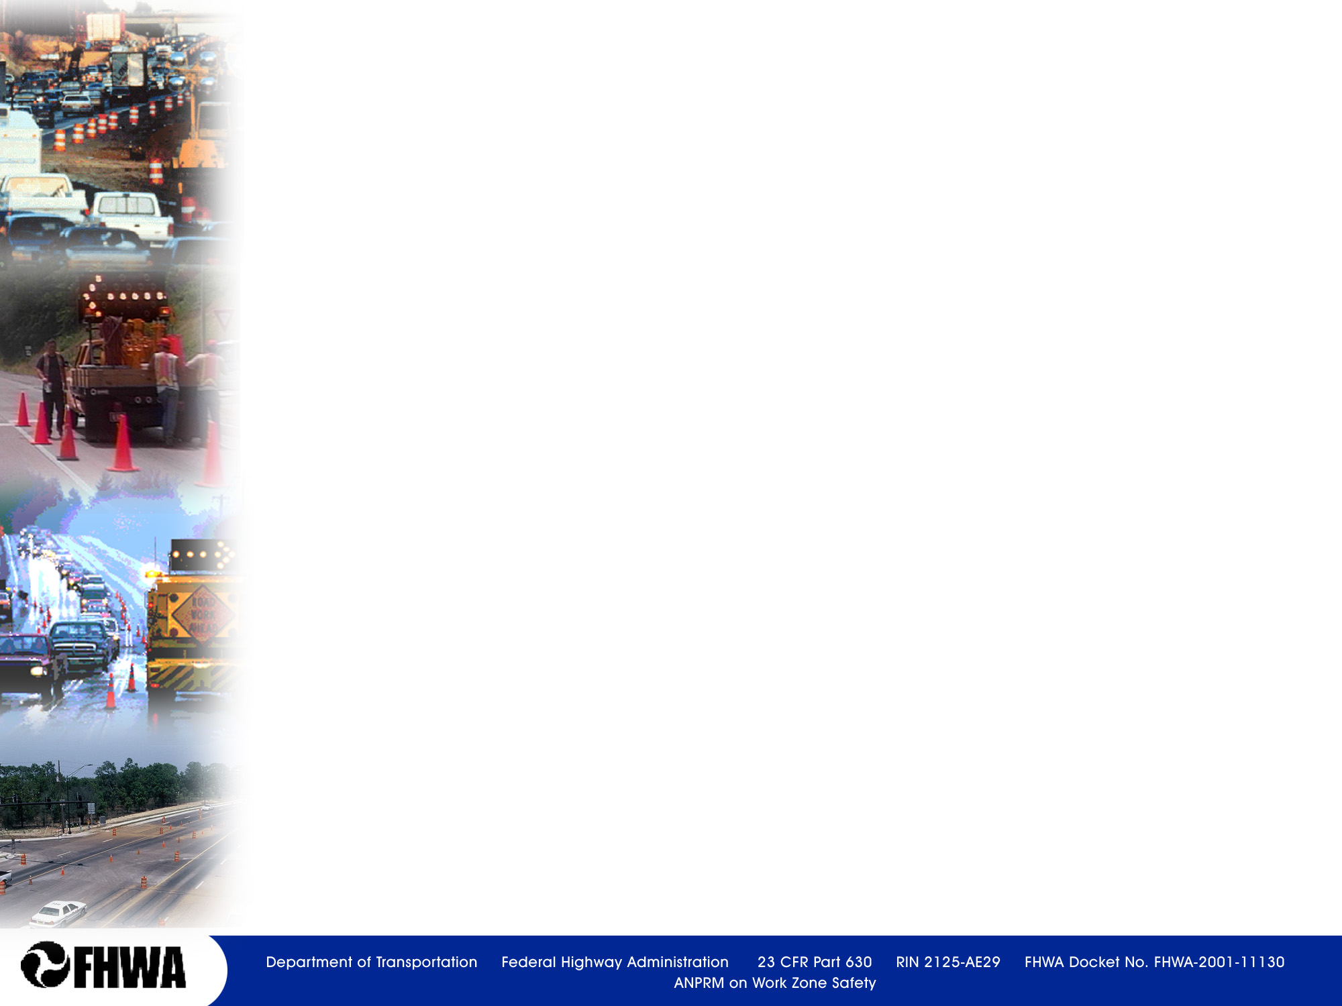

Work Zone Impact Strategies
Module 7

Slide 3
Identification of TMP Strategies
Should be based on:
  type of work zone
  traffic conditions
  anticipated WZ impacts
  project constraints
  construction phasing/staging plan
  conditions in surrounding area (e.g., alternate routes and modes, access)

Slide 4
Some Considerations
Agency WZ policies
  E.g., Maximum WZ queue lengths/delays allowed
Lane Closure policies/charts that specify when a lane closure is permitted
Analytical/modeling tools used by the agency
Concerns of stakeholders
Notes:
Some agencies use strict lane closure policies/strategies or permissible lane closure times that must be followed
Agencies may use analysis tools to predict delays, queues, and impacts of detours and compare these for various strategies
Lane closure policies/charts
Some state transportation agencies have developed lane closure policies, or strategies, that they use as guidance in determining daily permitted lane closure times.
Permitted lane closure times define what times of the day, week, or season a lane closure is allowed on a facility and at a specific location or segment.

Slide 5
Successful Strategies
Minimize traffic delays
Maintain or improve safety for road users and workers
Maintain business and resident access
Allow timely completion of the work

Slide 6
Work Zone Mobility Strategies
Full Closure
Phasing/ Staging
Restrict hours of operations
Manage Demand
Maintain Capacity

Slide 7
Full Closure
Provision in Subpart K
Safest for workers
Typically shortens project duration
Used successfully in urban areas where alternate route network exists

Slide 8
Full Road Closure Strategies
  Full road closure
  Weekend full closure
  Limited capacity closure
  Nighttime/off-peak closure
  Intermittent closure including rolling roadblocks
Notes:
Key Message: Full road closures are becoming a popular transportation management strategy.
Estimated Presentation Time:
Explanation of Cues/Builds:
Suggested Comments: When work under traffic first became necessary, it was common to close the road and complete work in the closed roadway section. However as traffic volumes increased and work under traffic became necessary on the Interstate system, closing the road was rarely used. Lane closures on high speed roadways put the workers and moving traffic very close. Working in one or two lanes at a time also slows the progress of work. Recently in an attempt to shorten the duration of work zones, agencies have closed major urban routes and done work on a full-time basis while the road was closed. Experience with full road closures has been very good and has reduced the time a road is affected by reconstruction. Some of the various types of closures are shown here.
Suggested Questions:
Additional Information:
Possible Problems:

Slide 9
Source: Full Road Closure for Work Zone Operations
Notes:
Key Message: Road closures have resulted in large reductions in project duration.
Estimated Presentation Time: 1 minute
Explanation of Cues/Builds:
Suggested Comments: Six case studies of full road closures revealed at least a 60% reduction in the project duration. For I-65 in Kentucky the work was accomplished in two weekends which translated into an amazing 95% reduction in the project duration!
Suggested Questions:
Additional Information:
Possible Problems:

Slide 10
Phasing/staging
By Halves/Sides
Adjacent/Parallel
Serial/Segmental
Closure/Detour
Combinations

Slide 11
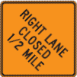

Applications
Lane Closure
Notes:
This work zone type closes off one or more normal traffic lanes. Capacity and delay analyses may be required to determine whether serious congestion will result from lane closures. In some cases, use of the shoulder or median area as a temporary lane will help mitigate the problems arising from the loss in capacity. Upgrading or replacement of existing pavement or shoulder, or placement of temporary pavement may be necessary.

Slide 12

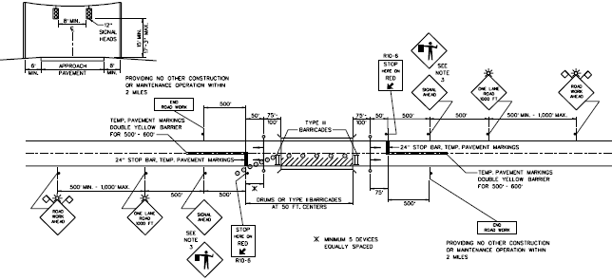
Applications
One-Lane/Two-Way Operation
Notes:
AKA Shared Right-of-Way. This work zone type involves utilizing one lane for both directions of traffic. This work zone type is typically only used on bridges or small, short-term projects. Flaggers or traffic signals are normally used to coordinate the two directions of traffic.

Slide 13

Applications
Runaround
Notes:
This work zone involves the total closure of the roadway (one or both directions) where work is being performed and the traffic is rerouted to a temporary roadway constructed within the highway right-of-way. This application may require the acquisition of a temporary easement and usually requires extensive preparation of the temporary roadway. Generally, temporary runarounds are designed for a posted speed reduction of no more than 5 mph to 15 mph below the existing posted speed of the route. Chapter 55 discusses the minimum geometric design criteria for runarounds.

Slide 14

Applications
Intermittent Closure
Notes:
This work zone type involves stopping all traffic in one or both directions for a relatively short period to allow the work to proceed. After a specific time, depending on traffic volumes, the roadway is re-opened and all vehicles can travel through the area. This application is normally only appropriate on low-volume roadways or during periods where there are very low volumes (e.g., Sunday morning, nighttime).

Slide 15

Applications
Use of Shoulder/Median
Notes:
This work zone type involves using the shoulder or the median as a temporary traffic lane. To use this technique for more than a short period, it will be necessary to evaluate the shoulder and subgrade to see if it is adequate to support the anticipated traffic loads. This technique may be used in combination with other work zone types or as a separate technique.

Slide 16

Applications
Lane Shift
Notes:
This work zone type is configured by reducing the width of one or more lanes to retain the number of lanes normally available to traffic. This application is the least disruptive of all work zone types, but it is generally only appropriate if the work area is mostly outside the normal traffic lanes. Note that narrow lane widths may reduce the facility’s capacity, especially where there is significant truck traffic. The use of shoulders as part of the lane width helps reduce the amount of lane width reduction that may be required; however, check the structural adequacy of the shoulders. Where this application is applied to long-term work zones, it will require the removal of the current lane markings to avoid motorist confusion. Chapter 55 discusses the minimum lane widths that must be provided.

Slide 17
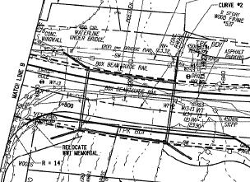
Applications
Roadway Shift
EXISTING
20’
PROPOSED
Notes:
This work zone type shifts the proposed roadway alignment laterally, (e.g., 50 ft, 100 ft) so that the existing roadway or bridge can be used as the means to maintain traffic flow at the work site. This is an option that is usually only appropriate at horizontal curve locations, or bridge sites where the roadway profile gradeline must be raised for hydraulic purposes. Note that additional right-of-way or easements will often be necessary for this work zone type.

Slide 18
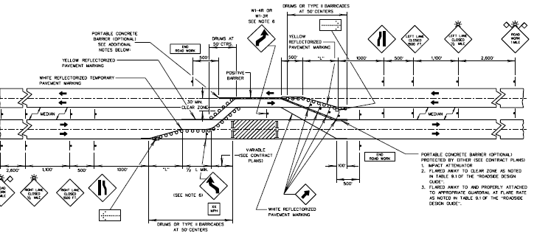
Applications
Crossover
Notes:
AKA Reconstruction By Halves/Sides. This work zone type involves routing one direction of the traffic stream across the median to the opposite traffic lanes. This application might also incorporate the use of shoulders and/or lane constrictions to maintain the same number of lanes. Due to the inherent high traffic volumes and, in most cases, higher speeds, it will be necessary to consider higher geometric criteria due to the higher motorist expectations. This approach involves the reconstruction of all lanes in one direction while the opposing lanes share the same roadway with traffic in the other direction. For high volume four-lane facilities, both shoulders may be rebuilt to provide four reduced-width lanes. For six-lane facilities, traffic is generally restricted to two lanes in each direction. This may require using the shoulders, reducing the lane widths, and/or providing minor widening. Under certain circumstances, depending on the median width and shoulder configuration, the inner lane of the two-way operation may not be readily accessible in the event of emergencies. Providing for emergency turnouts and/or emergency vehicle access at appropriate intervals on the segment under construction may be considered. Some advantages and disadvantages of this strategy include:
Advantages
• It provides an effective work area.
• Generally, workers are well separated from the traffic stream.
• Work site access can be arranged with minimal interference from the general traffic flow.
Disadvantages
• Positive separation of the traffic streams is required.
• There are potential emergency access problems throughout the project.
• There may be special problems at interchanges with traffic crossing the work zone.
• Reduced capacity.
The use of this application is encouraged under the following conditions:
• all safety issues can reasonably be addressed,
• construction time can be reduced,
• pavement and shoulder structures can be reasonably upgraded, and
• roadway geometrics allow crossover construction.
Chapter 55 and the Highway Standards discuss the design issues relative to designing two-way applications and crossovers (e.g., maximum length, pavement widths, pavement design, speed reductions). If this application is used, separate opposing traffic on high-speed facilities (i.e., posted speeds of 45 mph or greater) with positive barriers throughout the length of the two-way operation. Drums, cones, or vertical panels may be substituted for positive barriers in low-speed urban situations. The Highway Standards also depict the channelization devices that may be used with this layout. Consider also the option of reconstructing the shoulder to allow it to be used as a travel lane.

Slide 19
Restrict Hours of Work
Lane closure restrictions
  Work when traffic volumes are lower
Night work only
Weekend work

Slide 20
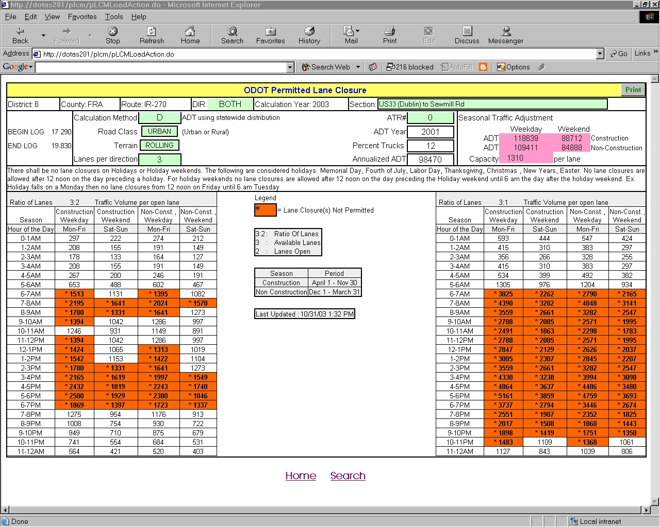
Ohio DOT MOT/PLC Policy
Notes:
Key Message: Example of guidance.
Est. Presentation Time: One minute.
Explanation of Cues/Builds: None.
Suggested Comments: The results of the analysis are presented in this fashion with the orange indicating times at which lane closures are not permitted. This information was developed for each segment of Interstate highway in Ohio.
Suggested Questions: None.
Additional Information: Information from the Ohio Policy 526-003(P), Traffic Management in Work Zones, Interstate Highways and Other Freeways.
Possible Problems: None.

Slide 21
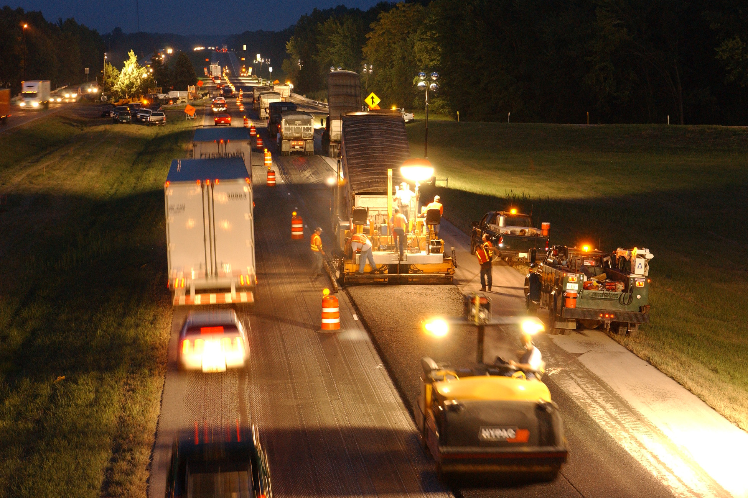
Night Work

Slide 22
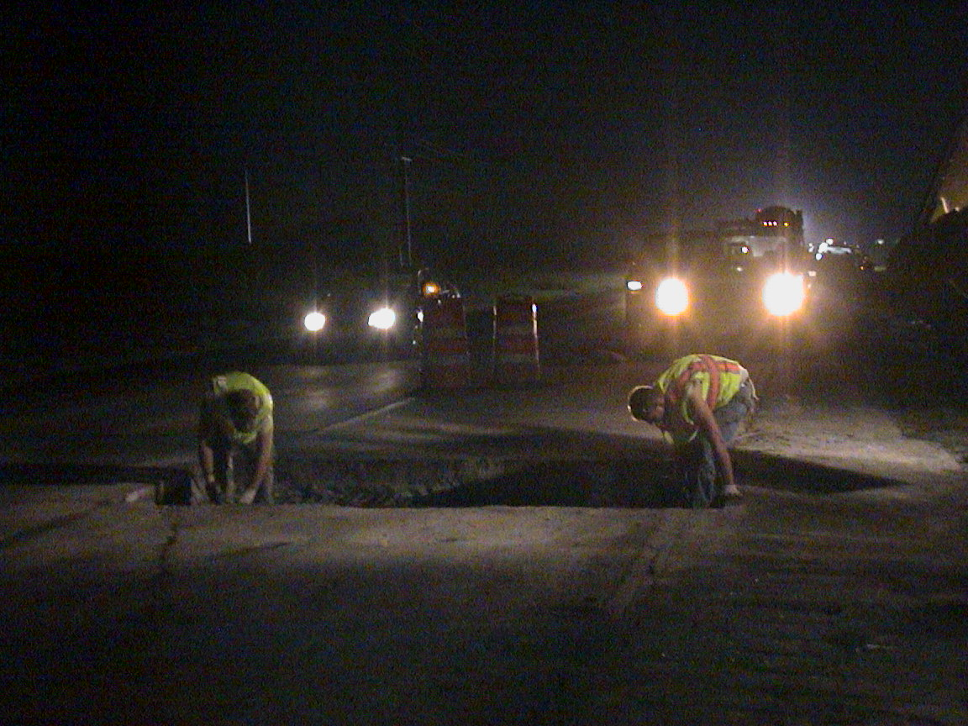
But do it safely

Slide 23
Recent Research
NCHRP 475 – Procedures to Determine when to Undertake Night Work
NCHRP 476 – Guidelines for Design and Operation of Nighttime Traffic Control
Notes:
Key Message: Research on night work zones has been recently published.
Est. Presentation Time: 1 minute
Explanation of Cues/Builds:
Suggested Comments: Two NCHRP reports about night work were published in 2002 and are aimed at improving the safety and efficiency of night work zone operations.
NCHRP Report 475 discusses how to determine if night work is appropriate. The overriding concerns of night work is that traffic volumes actually are lower at night , and that the roadway can be returned to normal for each daylight period.
NCHRP Report 476 presents guidelines for night work zones including additional traffic control that is needed at night. Lighting standards for various level of activity are also discussed. Seven night work typical applications are given in this report to illustrate the recommended traffic control to be used for various night work situations.
Suggested Questions:
Additional Information:
Possible Problems:

Slide 24
Traffic Operational Strategies
  Improvements to alternate route to accommodate additional traffic during project
    Traffic Signal retiming
    Intersection geometric improvements – commercial vehicles
  Incident management plan for work zone
  Demand reduction strategies

Slide 25
Manage Demand
Reduce demand to match reduced capacity through work zone
Cooperation from business, transit, and public necessary

Slide 26
Manage Demand: Reduce Total Travel
Discourage discretionary travel
Redefine essential travel (temporarily)
Non-traditional work schedules (e.g., 4-day weeks)
Telecommuting
Cooperation/support of major employers needed
Notes:
Key Message: Total travel can be reduced through cooperative effort.
Est. Presentation Time: One minute.
Explanation of Cues/Builds: None.
Suggested Comments: The first tactic is to reduce the total demand on the network by discouraging non-essential travel, especially during peak periods. The next step is to secure the cooperation of major employers and their employees in making some temporary accommodations during critical phases. Public and employer outreach programs solicit reductions in total travel through a reduction in the home-to-work trips. Alternative work schedules and work from home are common techniques. These types of initiatives used to face a lot of resistance. At a time of instant communications and information transfer many businesses and agencies have grown comfortable with the idea that employees do not have to be at a specific location at prescribed and common times. A transportation agency cannot change regional travel patterns in an organized way. This activity requires a true partnership between agencies, local governments, major employers and citizens. The transportation agency has to develop the plan collaboratively with the stakeholders and then everyone has to cooperate in executing the plan.
Suggested Questions: None.
Additional Information: None.
Possible Problems: None.

Slide 27
Manage Demand: Attenuate Vehicle Flow Rate
Notes:
Key Message: Manage demand to more evenly distribute flow through work zone.
Est. Presentation Time: One minute.
Explanation of Cues/Builds: None.
Suggested Comments: The fourth and last basic tactic is to flatten the demand curve. Although we normally try to accommodate peak flow rates, we’re learning this is not always feasible for permanent design or work zones. The blue graph indicates very pronounced am and pm peaks. Staggered work schedules (very early and late begin and end times) are a means of flattening the time-flow distribution.
Suggested Questions: None.
Additional Information: None.
Possible Problems: None.

Slide 28
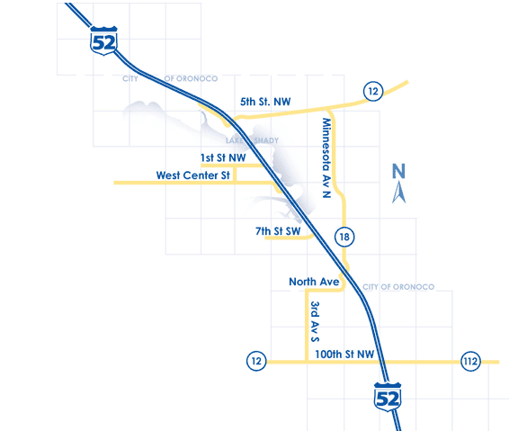
Manage Demand: Reduce Vehicles Through Work Zone
Encourage alternative routes
Agency led
Notes:
Key Message: Reduce the number of vehicles through the work zone by diverting traffic to other routes.
Est. Presentation Time: One minute.
Explanation of Cues/Builds: None.
Suggested Comments: The number of vehicles passing through a work zone can be reduced by publicizing and clearly marking alternative routes.
Suggested Questions: None.
Additional Information: None.
Possible Problems: None.

Slide 29
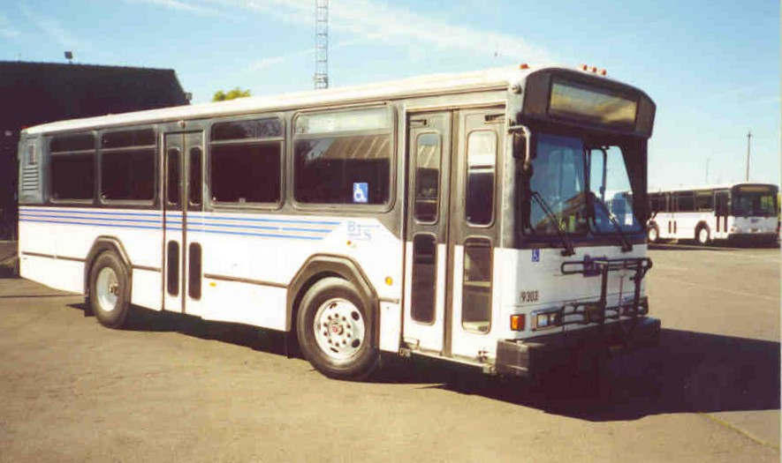
Manage Demand: Reduce Vehicle Trips
Special express bus
Additional transit service
Van and car pooling
Agency led; employer support helpful
Notes:
Key Message: Reduce the number of vehicles by alternative modes and high-occupancy vehicles.
Est. Presentation Time: One minute.
Explanation of Cues/Builds: None.
Suggested Comments: The next tactic is to reduce the number of vehicle trips on the affected network. As you know, in general we have very low vehicle occupancy rates. The one person per vehicle scenario is always inefficient but at times when capacity is substantially reduced it becomes unworkable. The number of vehicles on the network can be reduced by shifting essential trips on other modes and increasing vehicle occupancy. The listed items are common techniques.
Suggested Questions: None.
Additional Information: None.
Possible Problems: None.

Slide 30
Managing Demand (Vehicle Flow) Through WZ
Reduce daily person trips *
Reduce daily vehicles thru work zone (via alternative routes)
Reduce daily vehicle trips (via mode & occupancy rate)
Attenuate vehicle flow rate thru work zone *
Unmanaged demand
Managed demand
* Requires partnering with business & employers
Notes:
Key Message: A system and intense effort can reduce demand through the work zone.
Est. Presentation Time: Two minutes.
Explanation of Cues/Builds: None.
Suggested Comments: Through significant experience we’ve learned two basic lessons about travel demand management: (1) it’s not easy and (2) it can be done when it is absolutely imperative. The effort required for a successful demand management program is extensive. There are four common strategies that can reduce vehicle flow rates through work zones. Typically, all of these are applied through an integrated program. Several of these strategies are very dependent on the successful engagement and cooperation of major businesses and employers.
Suggested Questions: None.
Additional Information: None.
Possible Problems: None.

Slide 31
Maintain or Augment Capacity
Advance work to maintain capacity
  Widen/strengthen shoulders and utilize during construction
  Build structure off site and move with complete closure
  Others?

Slide 32
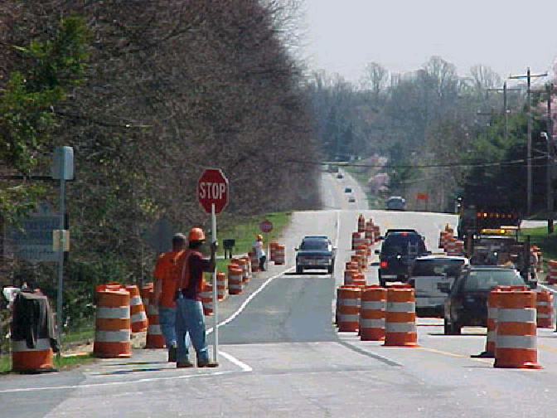
Maintain and Augment Capacity
Utilize/widen shoulder
Diversion
Reversible lanes
Parallel route improvements
Visual barriers
Notes:
Key Message: Mobility impacts can be managed by maintaining and augmenting capacity within the work zone.
Est. Presentation Time: Two minutes.
Explanation of Cues/Builds: None.
Suggested Comments: Now we’re going to look at the supply or capacity side. Whenever a lane is removed from service, there is a reduction in capacity. Additionally, because of reduced speeds, capacity is often lost in work zones even when all lanes are open. There are a number of techniques that can be used to maintain and augment capacity through the work zone:
Shoulders are often converted to travel lanes. In some cases, substantial construction is needed (width, pavement structure, slope, superelevation, rumble strips).
Diversions (runarounds) are offline temporary roadways that provide nearly equal capacity.
For multi-lane facilities with pronounced directional traffic patterns, one of the lanes many serve different directions at different times of the time.
There is a lot of experience with upgrading the geometry and traffic control on routes parallel to the work zone.
Work zones provide distractions that divert drivers attention and sometimes cause them to slow down. Some states install visual barriers or “gawk screens” to prevent distraction and improve capacity in the process.
Suggested Questions: None.
Additional Information: Photo obtained from www.centrevillede.info.
Possible Problems: None.

Slide 33
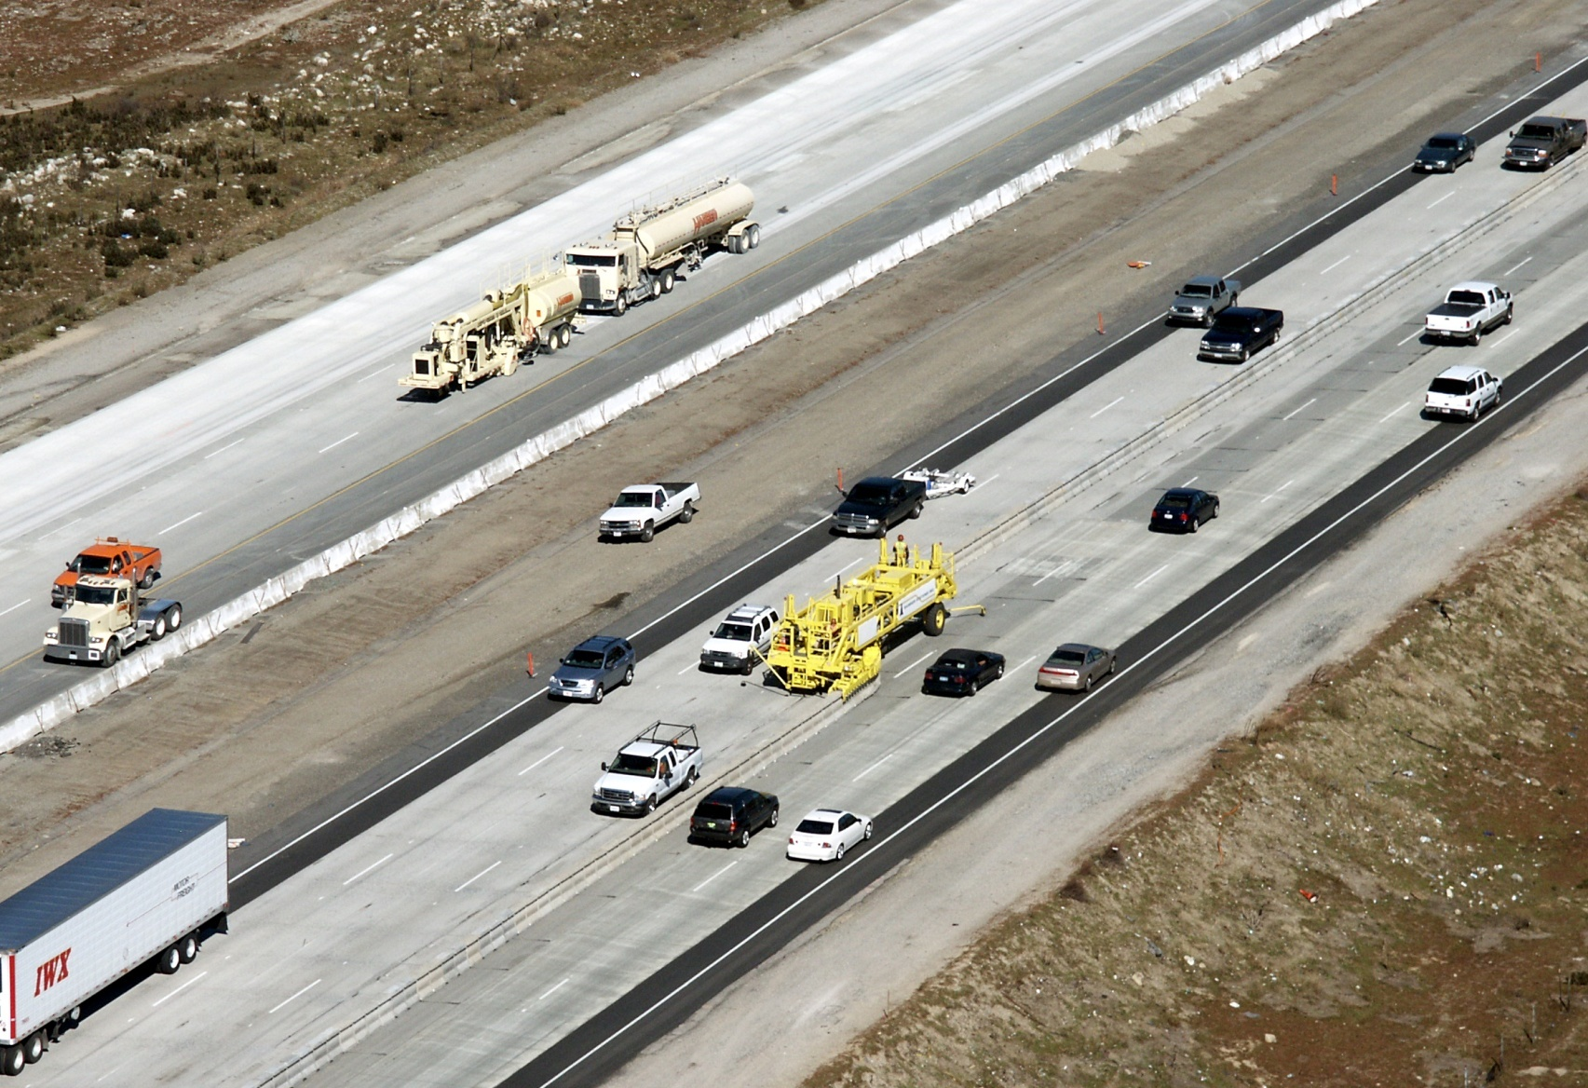
Reversible lane with moveable barrier
Notes:
Key Message: Example of capacity management
Est. Presentation Time: One minute.
Explanation of Cues/Builds: None.
Suggested Comments: This is an example of a moveable barrier being used to implement a reversible lane. This is two-way traffic on one directional roadway. By using part of the shoulders as travel lanes, five lanes have been created on a directional roadway with four permanent lanes. The barrier that separates directional travel is moved twice a day to allow three lanes in the heavy direction of flow.
Suggested Questions: None.
Additional Information: Photo obtained from Barrier Systems Inc.
Possible Problems: None.

Slide 34
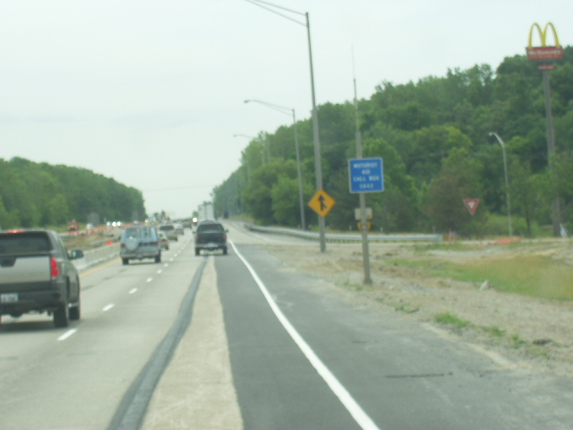
Shift to utilize shoulder
Notes:
Use of black paint to cover inappropriate pavement markings is not currently allowed per IDOT specs; should this be revisited?

Slide 35
Maintain and Augment Capacity
Alternative Modes
  Bus
  Rail transit
  Commuter rail
Incentives
Notes:
Key Message: Non-highway modes can offset the loss of highway capacity.
Est. Presentation Time: One minute.
Explanation of Cues/Builds: None.
Suggested Comments: Other modes can also be drawn on to compensate for losses in highway capacity. Shifting travel to transit and commuter rail removes vehicles from the highway network. Supplemental transit service (additional bus and trains) is often provided as part of major project. There are a number of motivating factors to change mode. Passing through the work zone is a disincentive to use the same mode and route. Incentives may include reduced or free fares, free parking at transit stations and employer-based programs.
Additional Information: None.
Possible Problems: None.

Slide 36
Innovative Contracting Strategies
Design – Build
  Accelerates process – work can begin as design is being completed
A + B Bidding
  Encourages reduced construction time
  Minimizes impacts
Lane Rental
  Charge assesses to contractor for lane closure
Incentive/Disincentive
  Encourages contractor to minimize construction time

Slide 37
Public Information Strategy
  Engage Stakeholders early
    Determine their needs
    Will they cooperate with other strategies
  Inform public of possible work zone impacts
  Significant projects may require major PR campaign
  Public may not be happy, but possibly “less mad…”

Slide 38
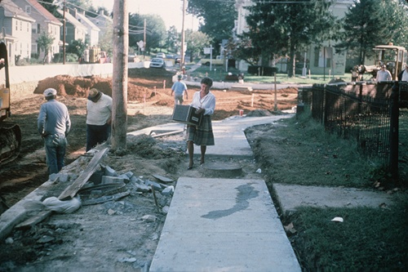
Community Impacts
Other User Accommodations
  “In urban or suburban areas where pedestrian activity is likely, pedestrian access must also be provided during construction. This may require providing temporary sidewalks, protection from drop offs, adjustment to traffic signals, etc.” (BDE)
  “The needs and control of all road users through a work zone shall be an essential part of highway construction, utility work, maintenance operations, and the management of traffic incidents.” (MUTCD)
Notes:
ALL USERS: Motorists, Bicyclists, Pedestrians (incl. Persons w/ Disabilities per ADA)
MUTCD: “It must be recognized that pedestrians are reluctant to retrace their steps to a prior intersection for a crossing or to add distance or out-of-the-way travel to a destination.”

