Slide 1
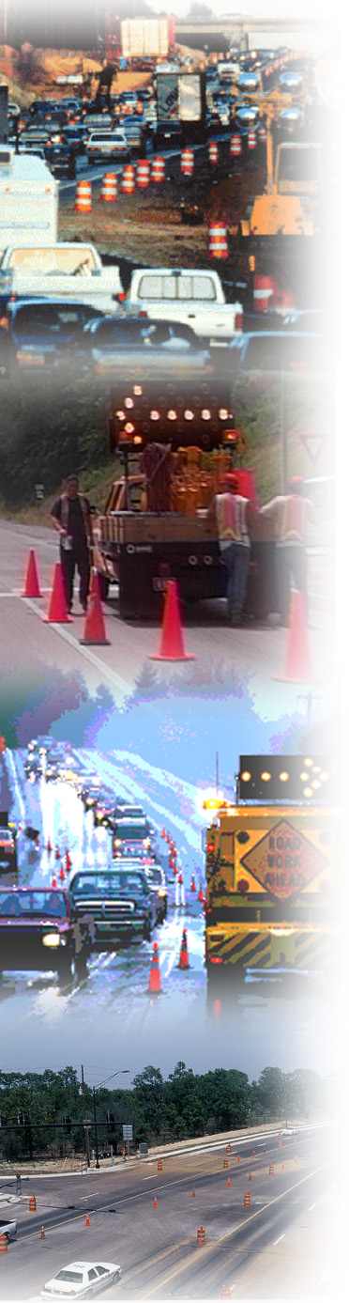

Example of Work Zone Impacts Assessment
Module 6

Slide 2
Example
Interstate 44 (I-44) through Pulaski County, Missouri

Slide 3
MoDOT Impacts Assessment
Policy requires impacts assessment for “significant projects”:
Project has full oversight by FHWA, or
Interstate project with:
  Duration >3 days, and
  Intermittent or continuous lane closures, or
Major Route project in an urban area, or
Projected capacity values exceed those in MoDOT’s Work Zone Guidelines
Notes:
MoDOT’s policy on impacts assessments directs project staff to analyze impacts on “significant projects.”
Significant projects are defined as meeting at least one of the following criteria:
-- he project is under full oversight by FHWA.
--It is an interstate project occupying a location for more than 3 days with either intermittent or continuous lane closures.
--Project is on a Major Route in an urban area. (As define by the Department)
--Project will cause capacity values to exceed those in MoDOT’s Work Zone Guidelines.
MoDOT uses a strategy matrix that assists project staff in recognizing potential impacts, and suggests possible strategies to mitigate the impacts.

Slide 4
Project Information
Rebuilt and repaired 8.9 miles of westbound lanes of I-44 in Pulaski County, MO
  3 interchanges
I-44 is over 60 years old
Option for 8” unbonded concrete overlay or 12” Superpave over rubblized concrete
Notes:
Interstate 44 (I-44) through Pulaski County, Missouri was built as part of the new Interstate system during the 1950’s and 1960’s, replacing the U.S. Route 66 corridor in the area.
Since then, traffic volumes and commercial vehicles have increased as communities became populated and businesses developed. The increases in volumes and weights meant greater need for maintenance and rehabilitation efforts would be needed.
Through many years of pavement overlays and pavement replacements since its original construction, I-44 became a mixture of pavement types, thicknesses, and ages. Recent efforts have focused on reconstructing the corridor by providing long-term pavement treatments that will serve motorists for years to come.

Slide 5
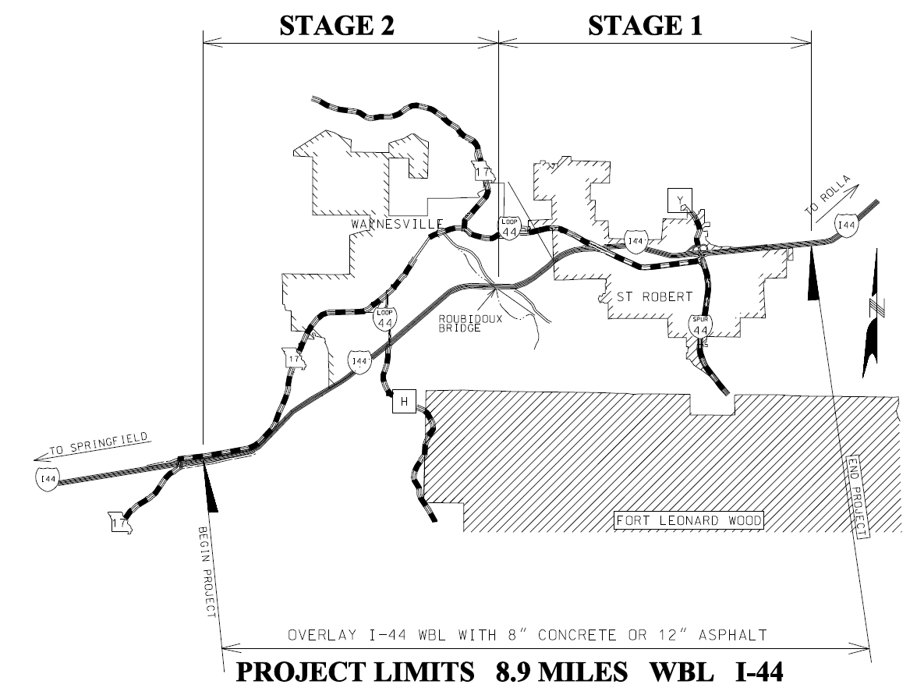
Project Location
Notes:
The project boundaries are Route 17 to 1 mile west of Route 28.
Project was originally planned for one stage. Through public input, MoDOT realized that if they split the project into two phases it opened up additional feasible alternatives.

Slide 6
Project Features
18,000 ADT in each direction
High truck volume (33% in some areas)
Up to 6% vertical grades
Sharp curves
Interchange area with narrow inside shoulder
  Concrete median barrier < 2 feet to travel way
Notes:
One interchange area has an inside shoulder that is significantly narrower than the standard 5 to 6 feet. For a 1 mile stretch, there is a concrete median barrier wall less than 2 feet from the travel lanes.

Slide 7
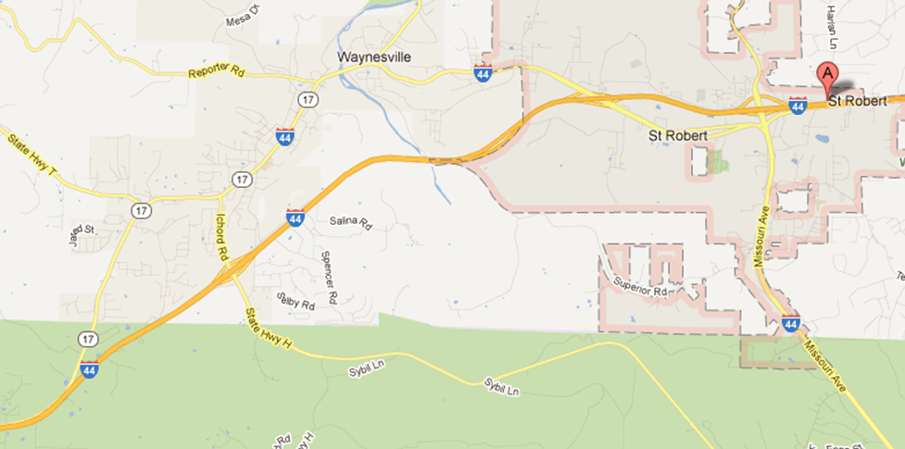
Project Features (cont.)
Quickest route between communities
Notes:
Quickest route between St. Robert and Waynesville.
Business Loop 44 (BL44) winds between the communities and through 2 of the interchanges. BL44 is comprised of several cross sections and speed limits – four lane divided with speed limit of 35 mph, 2+1 (with climbing lane) with speed limit of 35 mph, four lane undivided with center turn lane with speed limit of 35 mph, and two lane undivided with center turn lane with speed limit of 25-35 mph (except in CBD – is reduced to 20 mph for one block).

Slide 8
Project Features (cont.)
Directly services Fort Leonard Wood (FLW)
  Daytime population of 34,000
  Houses schools for U.S. Army
  Basic training graduation ceremony held weekly
Tourists use I-44 to get to Mark Twain National Forest
Population of region has grown 27% in past 10 years
Notes:
The influx of new residents and visitors provides for a constant mix of familiar and unfamiliar roadway users.

Slide 9
Involvement of Project Stakeholders
Stakeholder involvement and buy-in was critical to success
MoDOT held meetings to capture stakeholder input
Input helped shape
  Project criteria
  Alternatives analysis
  Impacts assessment
  TMP
Notes:
MoDOT held informational and consensus building meetings to capture stakeholder opinions, thoughts, and suggestions. The information gathered helped shape the transportation management plan (TMP) that was ultimately developed for the project.

Slide 10
Project Stakeholders
City government, law enforcement, and citizens of Waynesville and St. Robert
Chamber of Commerce members for communities
Fort Leonard Wood
Local media
Emergency Medical Services
Missouri State Highway Patrol
Trucking companies along I-44 corridor
Notes:
It was determined early in project design that it was imperative to the project’s success to include those who would be most impacted by the project.

Slide 11
Outcomes of Stakeholder Meetings
Temporary closure of Interstate ramps
  Alternating ramp closures and times of closures
  Lessens construction duration
  Minimizes impact to local business versus full ramp closure at all times
Travelers view WZ success in terms of delay
Communication of delay aids in congestion management
  Trucking industry
Notes:
For instance, after speaking with local business owners and community officials, MoDOT learned of their support for the temporary closure of Interstate ramps in an effort to lessen the construction duration.
Through customer surveys involving motorists who navigated other recent I-44 projects, MoDOT learned that delays in excess of 15 minutes impact how motorists view the success of work zone traffic management.
Discussions with regionally-located trucking companies proved crucial in helping reduce congestion attributed to commercial traffic. The trucking companies indicated that delay information received near real-time would assist dispatchers and drivers in routing to alternate roadways during times of congestion, or give drivers an opportunity to leave I-44 and rest if they were in transit and close to the work zone.

Slide 12
Project Criteria
15 minute delay threshold (MoDOT policy)
Minimize incidents and crashes
Public awareness
Traffic access to local communities
Accelerating project construction
Notes:
Some criteria were established based on stakeholder discussions.
It was important to locals to still have access to their communities, homes, businesses and schools.
After discussions with stakeholders, it was apparent that a communications strategy would be needed that would inform locals about ramp closure dates and times, as well as real-time travel delay information to help them determine a route to their destination.
Based on previous experience with other interstate projects, MoDOT took a position to reduce delay and queuing in work zones. MoDOT’s new standard for acceptability was 15 minutes or less of delay, which was based on the relationship between traffic volumes and queuing, as well as customer input.

Slide 13
Identification of Alternatives
During planning phase MoDOT focused on how to best reduce congestion
In-depth look at traffic volumes and patterns:
  Local traffic uses I-44 to bypass local roads
  Volumes on I-44 increase 12-15% after Memorial Day
Identified four alternatives for construction
Timing of alternatives analysis
  Done over a few months about 15 months before letting
Notes:
During the planning phase of this project, a primary question MoDOT asked was, “How do we reduce congestion?”
MoDOT took an in-depth look at traffic volumes and patterns and determined a substantial amount of I-44 traffic in this area is local traffic using I-44 to bypass local roads that go through communities. MoDOT would need to maintain a means of access to local communities since a significant number of I-44 users were not simply passing through the area. The traffic patterns showed MoDOT that it could reduce demand on I-44 by encouraging or requiring local motorists to travel on the local road network in lieu of entering I-44, provided the network had adequate capacity.
MoDOT also found that traffic volumes on I-44 increase after Memorial Day weekend, which led them to look for alternatives that could accelerate the construction to complete the project before Memorial Day
Timing - MoDOT stipulates that funding be in place for the selected alternative a year in advance of the letting. In this case, alternatives were identified and analyzed over the course of a few months, which pushed the start of this process to about 15 months before the project was to let.

Slide 14
Alternatives
Construction of the westbound lanes with the following scenarios:
  A single westbound lane closure.
  Full closure of both westbound lanes, crossover of one lane, head-to-head traffic with eastbound traffic (maintain one lane for each direction).
  Full closure of westbound lanes: diversion of traffic to local roads.
  Full closure of westbound lanes: diversion of traffic to US route detour.
Notes:
Several alternatives for construction staging and traffic management existed, and initially, four options were considered.
A single westbound lane closure.
Full closure of both westbound lanes, closure of one eastbound lane and moving traffic into a head-to-head scenario with the eastbound lanes.
Full closure of the westbound lanes and diversion of the westbound traffic onto an adjacent local roadway network that ran through the communities located along the project corridor.
Full closure of the westbound lanes and diversion of the westbound traffic onto two U.S. routes that would re-direct traffic from Rolla to Springfield on U.S. Route 63 South to U.S. Route 60 West.

Slide 15
Alternative 1
Single westbound lane closure
Past experience showed significant increase in delay in this area (>2 hours)
Combination of causes for past delay – some of these could be mitigated
Duration of 75 to 90 days
Notes:
The long delays are associated with a combination of: grades upwards of 6%, heavy commercial truck use (33%), and a reduction in motorist speed due to construction equipment adjacent to travel lane.
Could reduce the motorists distraction to mitigate some of the delay.

Slide 16
Alternative 2
Full closure of both westbound lanes: head-to-head traffic in eastbound lanes
Decreased exposure for workers
Construction duration of 45 to 55 days
Potential for manageable delays
Notes:
Decreased exposure – Traffic shifted to other side
Shorter duration – Closure of the one side increased contractor efficiency, resulting in shorter construction time
Delay reduction - Delays in Alternative 2 are estimated to be less than in Alternative 1 due to a buffer between traffic and construction equipment. The delays in excess of 2 hours on other projects were as a result of a single lane closure and construction equipment in close proximity to the travel lane.

Slide 17
Alternative 3
Full closure of westbound lanes: diversion of traffic to local arterials
Local roads had
  Low speeds
  Signalized intersections
  On-street parking
  Pedestrians
Alternative Dismissed: Due to limited capacity on the adjacent local roadway network and the presence of a central business district with on-street parking and high pedestrian volumes

Slide 18
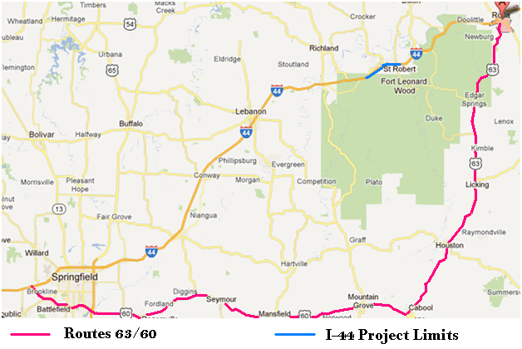
Alternative 4 - Full closure of WB lanes and detour to US routes
Delay – Increase of 30 minutes or more of travel time
Alternative Dismissed: Due to limited capacity and increase in travel time
Notes:
Alternative 4 was Full closure of the westbound lanes, with diversion of traffic to a detour along US routes detour that went through Rolla and Springfield.
Red line represents detour, goes through Rolla and Springfield.
Rolla is on I-44 approximately 30 miles east of the project.
Springfield is on I-44 approximately 60 miles west of the project.
Orange represents routes with construction (I-44).

Slide 19
Data Collection
Traffic volume counts on:
  Mainline I-44
  I-44 on- and off-ramps within project limits
  Local arterials
  A pre-determined alternate bypass route.
Percentage of heavy vehicles
Topographical data
Lessons learned from previous projects
Observational information from stakeholders
Traffic patterns and peak/off-peak times for traffic flow
Notes:
In order to determine the feasibility of the remaining two alternatives, several types of data were collected and include:
Traffic volume counts that included seasonal data, so as to help determine potential project beginning and end dates. Counts were collected on:
Mainline I-44
I-44 on- and off-ramps within project limits
Local arterials
A pre-determined alternate bypass route.
The percent of heavy vehicles on I-44.
Topographical data, including existing roadway grades and curvature.
Information on “lessons learned” from previous projects in this vicinity. One notable lesson that was previously determined was the need to calculate the capacity on I-44 in the locations of ramp merge points and the capacity of a single lane on the mainline near the head-to-head merge point. Previous experience showed that a single lane closure in one direction in this area resulted in up to a 2 hour delay for traffic.
Observational information from stakeholders, such as local government, EMS/enforcement, businesses, industries, schools, Fort Leonard Wood, Missouri State Highway Patrol, and MoDOT staff located within the project area.
Traffic patterns and peak/off-peak times for traffic flow determined through stakeholder meetings and engineering studies.

Slide 20
Impacts Assessment Overview
Analyzed impacts using:
  Traffic modeling software
  Traffic volume counts
  Roadway geometrics
  Road user cost index
Created scenarios for each alternative:
  Effect on mainline queuing from merging ramp traffic and various ramp closures
  Effects of various crossover locations
Notes:
The two alternatives – single lane closure and full closure of westbound lanes - were analyzed to determine which would best meet the core criteria.
Balance cost/efficiency of construction methods and staging with project goals:
Decreased delay
Increased driver and worker safety
Minimized construction duration.
Scenarios - Looked at various combinations of
--Ramp closure locations and times
--Where to put the crossover.

Slide 21
Analysis
Simulation with Synchro
Lessons learned from past projects
Public input
Notes:
Traffic modeling software, along with traffic volume counts and roadway geometrics, was used to project the feasibility of the remaining two staging alternatives. Analyzed various scenarios that involved two variables: the effect on mainline queuing from merging ramp traffic and a variable cross-over location where the westbound traffic would be put onto the eastbound lane.
MoDOT used Synchro simulation to determine the impacts of on/off-ramp closures during certain times of the day (for construction methods and to keep traffic flowing on I-44 without the disruption of merging traffic) and how those closures would impact local arterials. The simulation was also used to establish a cross-over location that would be desirable for traffic in both eastbound and westbound directions.
Information on “lessons learned” from previous projects in this vicinity. One notable lesson that was previously determined was the need to calculate the capacity on I-44 in the locations of ramp merge points and the capacity of a single lane on the mainline near the head-to-head merge point. Previous experience showed that a single lane closure in one direction in this area resulted in up to a 2 hour delay for traffic.
Observational information from stakeholders, such as local government, EMS/enforcement, businesses, industries, schools, Fort Leonard Wood, Missouri State Highway Patrol, and MoDOT staff located within the project area.
Traffic patterns and peak/off-peak times for traffic flow determined through stakeholder meetings and engineering studies.

Slide 22
Key Issues
Steep grades
  Impact on ability for traffic to maintain speed and converge into one lane before crossover point
  Impact on ability of motorists to achieve desirable speed while merging from ramps into more dense traffic volumes

Slide 23
Key Issues
Possibility of maintaining existing ramp traffic
  Impact on ability of motorists to merge onto I-44 from ramps
  Impact to local businesses
  Impact to construction duration
Consider ramp closures
Consider phasing project (2 phases)
Notes:
Impact on the ability of motorists to merge onto I-44 from Ramps:
Into more dense traffic volumes on I-44 while not impacting speeds of mainline
Found to be sensitive to time-of-day and direction
Without causing additional back-ups and congestion on local arterials
MoDOT staff determined that ramp closures would have a positive impact on reducing the queues on I-44. However, traffic volume modeling showed that closing all ramps within the 9 mile project would have unfavorable effects on local arterial roadways within communities of St. Robert and Waynesville. Not only would roadways be clogged with traffic, but residents, business, schools, and services would be essentially cut-off to corridor traffic, and in some cases, for local use as well.
To alleviate the severity of these impacts, the project would be staged into two parts,. Ramps located within the limits of staging not under construction were to remain open and operable. Staging the project into two parts would allow access to the local communities by leaving ramps in the non-head-to-head areas open at all times, without the disruption to traffic normally associated with ramp merges.

Slide 24
Effects of Key Issues on Alternatives
Alternative 1
  Grades and lane configuration stay the same
  Ramp closures
    Strategically selected to limit disruption to I-44 traffic and optimize construction method/duration
Alternative 2
  Iterative process to:
    Find location of crossover
    Establish ramp closure times/days
Notes:
How did each of these affect Alternative 1 and Alternative 2?
For Alternative 1, MoDOT used Synchro simulation and traffic volume data to determine the impacts of on/off-ramp closures during certain times of the day (for construction methods and to keep traffic flowing on I-44 without the disruption of merging traffic) and how those closures would impact local arterials, as well as the effect steep grades would have on the location of the lane drop and ramp merge locations.
For Alternative 2, the scenarios involved simulating the effect on traffic queues caused by placing the crossover at locations with varying degrees of grade and proximity to interchange access, coupled with restricted ramp access at varying times of day and the week. Through many Synchro traffic simulation iterations, optimal cross-over locations in the westbound and eastbound directions were determined and ramp closure times were established.

Slide 25
Simulation Results – Alt. 1
Eastbound lanes
  Lane configuration and grades stayed the same
  Little change from existing traffic flow
Westbound lanes
  Past experience - >2 hours delay on mainline due to lane drop, merges, and work proximity
  Simulation results - grades had little effect at ramp merge area. Experience showed otherwise.
  Entering volume from ramps caused further congestion on I-44
Notes:
East bound - Since the eastbound lane configuration and grades remained the same, simulation showed little change – minor changes to traffic flow do to reduced work zone speed limit. Overall, the effects on the eastbound lane were negligible.
West bound - When the westbound lanes were simulated with a reduced lane, coupled with the experience gleaned from past projects, the resulting traffic flow showed to undergo extreme delays, upwards of 2 hours.
Synchro simulation showed that roadway grade did not attribute to mainline congestion or motorists’ ability to merge from ramps, HOWEVER, previous experience showed that steep roadway grades at ramp merge points could seriously disrupt mainline traffic. In cases where the ramp merge areas required motorists to merge into one lane of traffic with relatively steep grades (3-4% or greater), merging traffic had difficulties getting up to the same speed as mainline traffic before merging, causing serious disruptions in flow within the work zone. Likewise, motorists merging onto I-44 from any open ramp had negative impacts on mainline traffic by introducing additional volume to a single lane of westbound motorists (already experiencing significant delays), especially during peak hours.

Slide 26
Simulation Results – Alt. 2
Eastbound and Westbound lanes
  Simulations and experience with respect to grades and ramp merges were similar to the Westbound situation for Alternative 1.
  Difference: Delay with head-to-head could be managed to meet expectation of <15 minutes.
Notes:
For the Eastbound and Westbound lanes, simulation showed no impact to traffic if the EB lane drop and WB crossover was within the vicinity of a steep grade – however, experience showed that grade had a negative impact on merging traffic, especially where commercial vehicles were prominent. For this reason, it would be necessary to locate the EB lane drop and WB crossover near a flat grade.
Similarly, simulation of the effect on grade at ramp merges in the Eastbound and Westbound lanes showed little impact to I-44 traffic. HOWEVER, previous experience showed that steep roadway grades at ramp merge points could seriously disrupt mainline traffic. In cases where the ramp merge areas required motorists to merge into one lane of traffic with relatively steep grades (3-4% or greater), merging traffic had difficulties getting up to the same speed as mainline traffic before merging, causing serious disruptions in flow within the work zone. Likewise, motorists merging onto I-44 from any open ramp created additional volume to a single lane of Eastbound and Westbound motorists, especially during peak hours. SIMULATION RESULTS FOR ALTERNATIVE 2 ARE ESSENTIALLY THE SAME ISSUES AS PRESENTED IN THE SIMULATION RESULTS FOR ALTERNATIVE 1 – with one exception: Delays associated with single lane drop were known from experience to exhibit delays (2 hours) in excess of the 15 minute expectation.
For Alternative 2, simulation showed the effect on traffic queues caused by placing the cross-over at locations with varying proximity to interchange access (since a flat location was identified for the crossover and lane drop), coupled with restricted ramp access at varying times of day and the week. Through many Synchro traffic simulation iterations, optimal ramp closure times were established in the Eastbound and Westbound directions such that delays would be held to 15 minutes or less.
Selection of ramp closures and their associated times occurred by using existing traffic counts and their corresponding predominant movements. Ramps near FLW and schools were known to have an influx of volume during dismissal times. Depending on estimated mainline I-44 volumes during these times, ramps may be closed, forcing the corresponding traffic to local roadways. For instance, since I-44 experienced higher traffic volumes on Friday afternoons, when schools or the Fort dismissed, the additional volume surge from this traffic would overwhelm I-44 and was forced to remain on the local system. Comparatively, schools or the Fort dismissing on a Tuesday afternoon may have little effect on I-44 congestion, and subsequent ramps could remain open.

Slide 27
Selected Alternative
Alternative 2 - Full closure of both westbound lanes, crossover, run one lane in each direction on eastbound side
Maximum head-to-head days allowed was 45 days
  Incentive/Disincentive of $40,000 per day
Notes:
Alternative 2 was selected for this project based on:
--District 9’s past experiences with long-term treatments on I-44
--Comments received from contractors.
--Likelihood of considerably less delay, as compared to Alt 1.
--Enables the contractor to greatly accelerate project completion and is safer for the contractor’s employees.

Slide 28
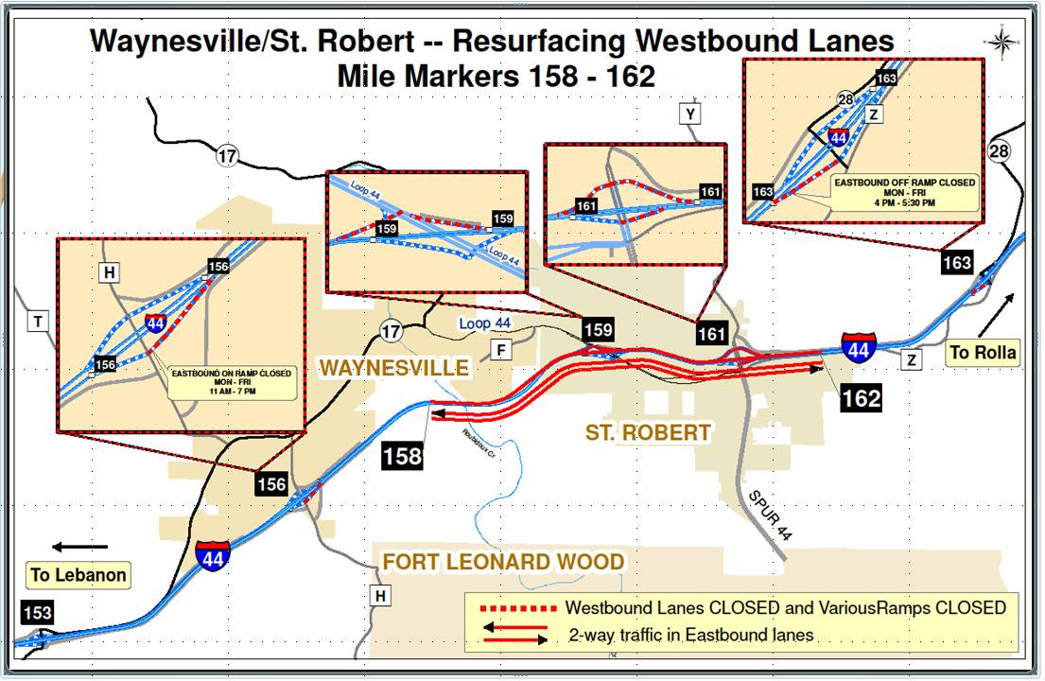
Stage 1 – April 2011
Notes:
Stage 1 – April 6 to April 17, 2011

Slide 29
Stage 2 – May 2011
Notes:
Stage 2 – May 3 to May 13, 2011

Slide 30
Impacts Mitigation Strategies
Minimize Incidents and Crashes
  24/7 Work Zone Supervisor
  Temporary Rumble Strips
  Synchronized Warning Lights at Lane-drop Taper
Notes:
A contractor-provided work zone supervisor, who was available 24 hours a day and 7 days a week, was used on the project to ensure the traffic control devices were always in place and in good condition. This work zone supervisor was available around the clock should changes or adjustments to traffic control strategies be needed in order to adapt to any changing traffic flow conditions.
Temporary rumble strips were used at each end of the work zone to provide an audible warning to motorists, in an effort to alert them of changing roadway conditions. The rumble strips were intended to bring about driver alertness and draw their attention to their surroundings. To help guide drivers near the cross-over locations during nighttime travel, temporary lighting was used at each temporary median cross-over location for better illumination to help drivers better negotiate the curves.
Synchronized warning lights were utilized on the channelizers along the lane-drop taper section at each end of the project. This brought about driver awareness, but also provided nighttime drivers increased visibility within the work zone.

Slide 31
Impacts Mitigation Strategies
Minimize Delay
  Adjust signal timings on incident bypass route
  Signed alternate bypass route
  Construction staging
  Demand management/reduction
Notes:
Incident bypass route - Traffic signals on arterials would be adjusted to alternate timing if an incident in the head-to-head portion of I-44 would cause all traffic to be rerouted to the alternate bypass route. A timing plan was established, giving priority to mainline traffic that would consist of diverted I-44 traffic, and installed at each signalized intersection as the secondary timing plan. While any changes to signal timings are usually performed by the engineer, a control was installed within each cabinet that would allow MoDOT personnel assigned to the project the ability to switch to the alternate plan when I-44 traffic was put on the alternate bypass route. This minimized the stop-and-go effect that would have otherwise occurred as a result of the heavy traffic volumes.
Signed bypass route - To help reduce delay, motorists were given a permanent alternate option as to how to navigate the work zone. An alternate bypass route was established with permanent signing showing motorists how to leave I-44 on their own accord, should they encounter back-ups or delay notifications that were unacceptable to them. The alternate bypass route would be used exclusively for I-44 traffic when an incident occurred on I-44 that prevented travel in one or both of the two lanes that were open to traffic. The route was signed according to which stage of construction was occurring, which affected which on/off ramp motorists would take.
Staging - Staging the project into two parts allowed access to local communities by leaving ramps in the non-head-to-head areas open at all times, while reducing the disruption to traffic of ramp merges. Using two phases also enabled MoDOT to better coordinate the impacts with a concurrent bridge closure/reconstruction project on the west end of the project’s limits.
Demand mgmt – Ramp closures also forced some of the local traffic to remain on local roads, reducing demand on I-44.

Slide 32
Impacts Mitigation Strategies
Keep the Public Informed
  Use of portable changeable message signs and dynamic message signs
  Extended hours for Customer Service Center
Notes:
In order to inform the public about real-time delay in the work zone, portable changeable message signs (PCMS) were set up at various decision making points within and outside of the project’s limits. For example, although Fort Leonard Wood’s main entrance is approximately 4 miles outside of the work zone limits, a PCMS was installed for traffic leaving the base, headed into the construction work site, notifying them of the delay they could expect to encounter. The Fort has multiple gates that allow access to I-44 at different mile markers, giving drivers familiar with the area and Fort options around the congestion.
Under normal circumstances, the District’s Customer Service Center (CSC) operates from 6:30 a.m. to 5:00 p.m. Each District within MoDOT has their own CSC, which helps puts motorists who call within that area in contact with someone who is extremely knowledgeable about and familiar with the area. To better share work zone related information with motorists during this project, the hours of the District CSC were expanded to 7:00 p.m. Thursday and Friday, and from 12:00 p.m. to 7:00 p.m. on Sundays, times that were determined based on an increase in traffic volumes on I-44, as documented by traffic counts and observation.
Responsibilities of the CSC are to monitor Interstate 44 cameras, receive phones calls and collect information from the on-site motorist assist truck operators. With this information, the Dynamic Message Signs (DMS) and PCMS were to be changed from the CSC to display “real-time” informational/warning messages to traveling motorists for their use in choosing alternate routes in an effort to relieve congestion.

Slide 33
Impacts Mitigation Strategies
Reduce Construction Duration
  Construction method
  Contract incentive/disincentive
  Completion before peak seasonal traffic
Notes:
Choosing Alternative 2, which closed the westbound lanes:
--Enabled the contractor to greatly accelerate project completion
--Safer work environment for contractor’s employees.
--Maximum head-to-head days allowed was 45 days with an incentive/disincentive of $40,000 per day.
--Traffic volumes are approximately 12-15% less in the months prior to Memorial Day than in the summer months. With this in mind, the allowable timeframe set up in the contract for head-to-head traffic was between April 1 and May 23, 2011. This allowed for construction to occur within a window after winter and before increased summer traffic.

Slide 34
Documentation of Findings
Results of analysis kept in project files
  Includes minutes of meetings with internal and external stakeholders
Findings reflected in TMP and impacts mitigation strategies

Slide 35
Project Outcomes
Success! Adherence to the core criteria:
Limited traffic to a maximum of 15 minutes delay on I-44
Kept public informed
Minimized incidents and crashes
Allowed access for traffic into local communities
Fast-tracked project to reduce construction duration
Notes:
Delay met expectations on I-44.
Project staff noted that there were no work zone crashes and minimal disruption to interstate traffic over the project’s life.
Head-to-head operation allowed the contractor to complete the unbonded overlay more quickly by eliminating the need to stage operations around traffic using an on-ramp.
Project was finished before increase in traffic volumes that occurs after Memorial Day.
The mitigation strategies used in this project decreased the project duration, which also led to public support.

Slide 36
Project Outcomes – Local Road Network
As expected, ramp closures caused increased congestion on local roads
Delays similar to traffic simulation results
Residents were told to expect more congestion on local roads to mitigate delay on I-44
  Prior communication led to patience
  Travel time increased from 10 minutes to 30 minutes
Notes:
As expected, ramp closures did cause increased congestion on local roadway networks. Increased road usage on local roads occurred during the morning, lunchtime and afternoon peak periods – with congestion lasting for 3 hours in the afternoon and travel time increasing from 10 minutes to 30 minutes. Delays were in line with what was estimated by the traffic simulation, and because of prior communication about these possible delays, local residents were understanding.
MoDOT was concerned about a delay of less than 15 minutes on the Interstate only - not on local roads.
The communities were told that more congestion would occur on local roads as a way of mitigating delay on I-44, but because of prior communication about these possibilities, local residents were understanding.

