Slide 1


Work Zone Impacts
Assessment
Module 5

Slide 2
Overview
Work Zone Decision Making Process
Work Zone Impact Assessment
Work Zone Traffic Analysis
Incorporating Results
  Policies
  Multiple Project Coordination
  Project Impact Prioritization
  Project Work Zone Management Strategies

Slide 3
What is a WZ Impact Assessment?
WZ Impact Assessment is the process of understanding the safety and mobility impacts of a road construction or maintenance project
Notes:
What is a WZ Impact Assessment - WZ Impact Assessment is the process of understanding the safety and mobility impacts of a road construction/maintenance/rehabilitation project. This constitutes:
Assessing the likely WZ impacts and developing appropriate work zone transportation management plans (TMPs) during project development and delivery
Monitoring the actual impact of the project and making adjustment to the TMP(if necessary) during the project implementation
Conducting performance assessment to track performance, document lessons learned and identify trends towards overall improvement of WZ policy, procedures and practices.

Slide 4
TMP Development Process
Assess Broadly Early in Process
Analyze Specific Impacts & Strategies
Notes:
BUT ALSO IN CONSTRUCTION & PERFORMANCE ASSESSMENT

Slide 5
Basic Concept
Determine impacts of project?
  Acceptable? If yes, no problem
  Unacceptable? (Significant project)
    Can strategy be found to mitigate impacts to acceptable level?
      Yes – develop TMP
      No – determine best strategy
      Advise stakeholders of possible problems
Notes:
EMPHASIZE THIS SLIDE

Slide 6
WZ Impacts Considerations
Maximizing Safety
  Road Users
  Workers
Maximizing mobility and accessibility
  Road user costs
  Emergency services
  Businesses
Constructability
  Building projects effectively and efficiently

Slide 7
Benefits of Assessing Impacts
Identify and understand all impacts of the project
Identify “significant projects” and determine suitable TMP
Aid in identifying and evaluating alternative strategies
Monitor and manage WZ impacts during construction

Slide 8
Mobility Impacts
Mobility Issues
  Delay
    Reduced quality of life issues
    Significant Projects – agency definition
    Reduced Speeds
    Queues and complete stoppages
  Freight Interference
    Travel time reliability – biggest concern
    Delayed deliveries
    Unanticipated costs
  Emergency response

Slide 9
Safety Impacts
Road user exposure to hazards
  Will staging create safety hazards greater than existing?
Worker exposure to traffic
  Staging allow for positive protection?
  Construction technique occupational risks?
Geometrics during phases
Availability of law enforcement
Speed reduction necessary/considered?

Slide 10
Business Impacts
Access
  Temporary entrances
    Signing
    Pavement
  Advance notification of phase changes
    Keep owners informed
Work Schedules
  Christmas shopping season
  Weekends

Slide 11
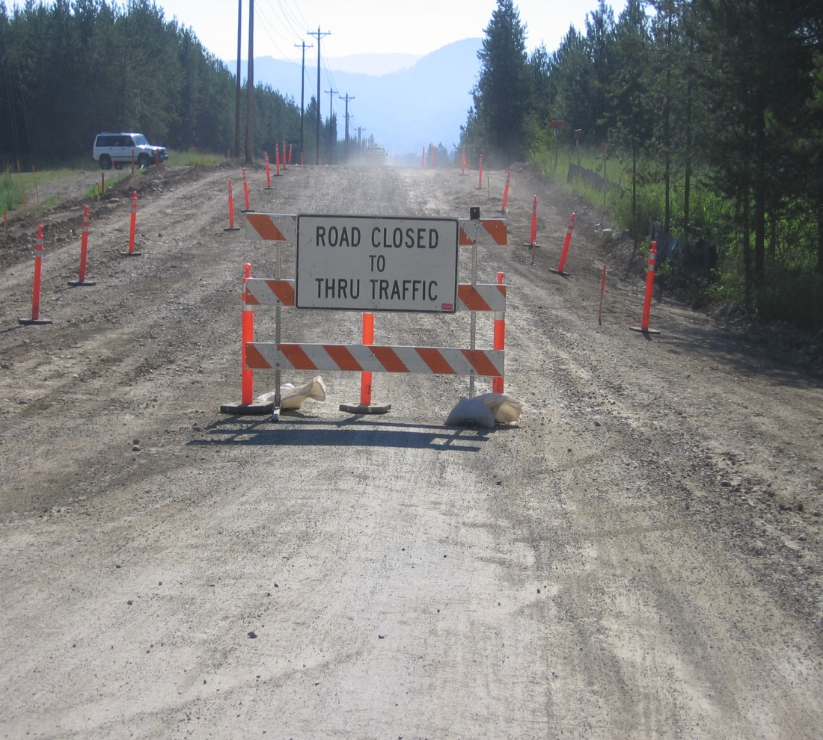
Residential Access Impacts
Keep residents informed as project begins and progresses
  Neighborhood association meetings, newsletters, mailings, etc.
  Maintain access if possible

Slide 12
Incident Response Impacts
Ensure access to all areas for emergency vehicles
  Hospitals nearby?
  Trauma centers?
Plan to provide access within work site
  Identify alternate routes
  Pre-sign for use during incidents?

Slide 13
Transit Impacts
Transit route through project?
  Bus stops
  Alternate routes available
  Include in PR information

Slide 14
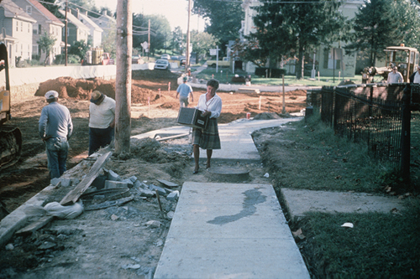
Pedestrian Impacts
MUTCD Part 6D:
  If project affects the movement of pedestrians, adequate pedestrian access and walkways shall be provided.

Slide 15
Impact Assessment
Proactive versus reactive
Use early in the TMP Development process to identify and estimate the magnitude of the impacts
Assess impacts on regional basis
Use assessment to help evaluate various strategies for mitigating impacts
Possibly use assessments to justify TCP revisions after award of project
Notes:
EMPHASIZE THIS SLIDE

Slide 16
Traffic Impacts & Analysis
Historical knowledge – “Lane closures do not cause backups on this segment of road…”
Various levels of tools for more detailed analysis
  Sketch Planning Tools
  Travel Demand Models
  Traffic Signal Optimization Tools
  Macroscopic Simulation Models
  Mesoscopic Simulation Models
  Microscopic Simulation Models

Slide 17
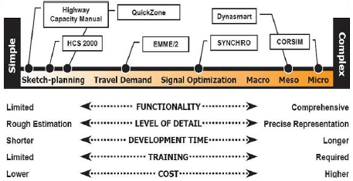
WZ Analysis Tool Model Spectrum

Slide 18

Work Zone Traffic Analysis Guidance http://ops.fhwa.dot.gov/trafficanalysistools/index.htm
Vol. VIII for Decision-Makers
  “Decision-Making Engine”
  Selecting correct tools
  Guidance for engineers & reviewers
Vol. IX for Analysts
  Case studies
  Guidance for analysts
Vol. XII “Decision Framework”
  Maintenance of Traffic Alternatives Analysis (MOTAA)
  Modeling Tool Selection Framework
  Model Development & Application Process
  Detailed Case Studies

Slide 19
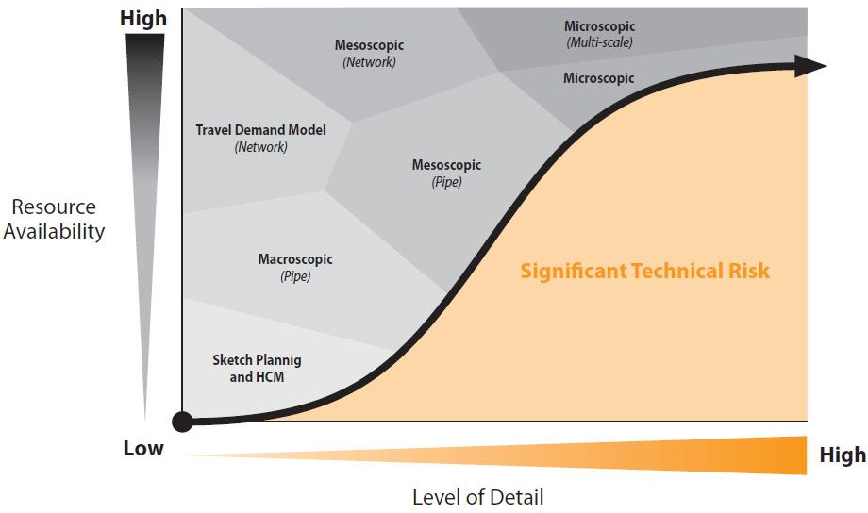
Analytical Work Zone Decision Framework – Modeling Approaches

Slide 20
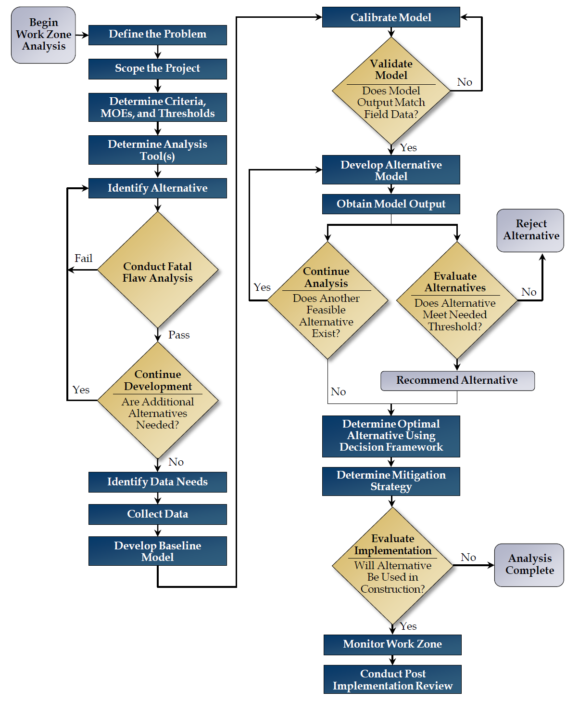
Maintenance of Traffic Alternatives Analysis & Decision Framework Flowchart
1. Establish MOT Alternatives Context
2. Evaluate & Select Analysis Tools
3. Develop Full Range of MOT Alternatives
4. Design & Build Baseline Analysis Model
5. Establish Decision Framework & Screen Alternatives
6. Select, Implement, Monitor, Review Preferred Alternative

Slide 21
How Should Results of Assessment Be Utilized?
Formulate policies
Identify significant projects across an program or highway network
Identify critical issues to address in development of TMP
  Alternate route availability
  Effects on businesses and residents
Identify project-specific strategies that will minimize impacts

Slide 22
Review and Discussion
When should the Impacts Assessment take place in the TMP process?
Does your state have a procedure in place to assure impacts are factored in to the project planning and design?

