Slide 1
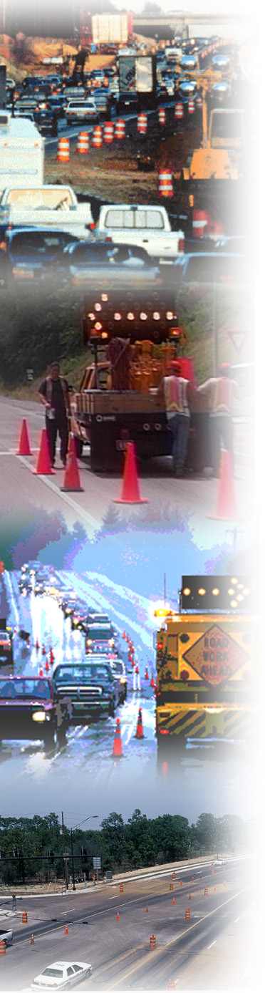

Examples of Work Zone Best Practices
Module 4

Slide 2
Policy

Slide 3
Washington State DOT WZ Policy
Establishes roles and expectations
Fosters more communication and cooperation by providing common understanding of expectations
“Effective work zone safety and mobility strategies minimize traffic delays and provide a safe environment in which to work and drive."
-WSDOT WZ Policy Statement
Notes:
Developed through the collaborative efforts of the WSDOT Development Team; Work Zone Safety Task Force; Program Managers; and Communications Office.
The intent is not to provide details, such as processes, procedures, and solutions, but to establish roles and expectations for the identified program areas. In this way, WSDOT is not introducing the Rule as a new program or a new process, but it is building it into the existing WSDOT program structure.
WSDOT feels that the policy allows for greater communication and cooperation from all the groups affected by the Rule by providing a clear understanding of expectations.

Slide 4
Michigan DOT WZ Policy
Applies to all State trunklines, including freeway and non-freeway facilities
Applies to all types of work zones
Memos and presentations on policy given to all personnel
MDOT credits its WZ Safety and Mobility policy as the catalyst to look outside of normal operations when planning, designing, and constructing a project.
Notes:
MDOT executive management tasked the MDOT Operations Engineer in the Division of Operations with developing a WZ safety and mobility policy in late 2006.
Convened a group comprised of one representative from each of the seven MDOT Regions and representatives from the MDOT Traffic and Safety Division, MDOT Bureau of Transportation Planning, MDOT Design Division, MDOT Construction Division, a communications specialist from the Detroit Metro Region, and two representatives from the FHWA MI Division Office. This group met several times over 3-4 months to draft the policy. In writing the policy, the group determined that MDOT was already following most of the Rule requirements and would primarily need to document what they were already doing.
Work Zone Safety and Mobility Manual goes into more specifics than the policy, detailing who does what and how, as well as specific things to take into consideration when designing and scoping a project. The same team that wrote the MDOT Work Zone Safety and Mobility Policy reconvened for five months to develop the manual. By providing consistent terminology, sample forms, checklists, and documents, the manual has helped to make work zone operations consistent across the MDOT Regions.
Done some outreach and training to educate personnel about the Policy and Manual. Sent out memos, gave presentations about the policy and process at statewide design, real estate, construction, utility/permit, and maintenance conferences. Central Office has also partnered with individual Regions to talk about the process.

Slide 5
Impacts Assessment

Slide 6
Ohio DOT MOT Alternatives Analysis
Used to identify and analyze potential WZ impacts “constraints” early in project development
Occurs PRIOR to the first detail plan submissions
Early so that MOT can be used to help:
  Pick between feasible project alternatives
  Size structure widths
  Highlight WZ right-of-way and environmental impacts early enough to do something about them
The goal of the MOTAA is to identify potential traffic safety and mobility problems prior to detailed design so that a solution can be engineered into the design.
Notes:
Developed in 2003

Slide 7
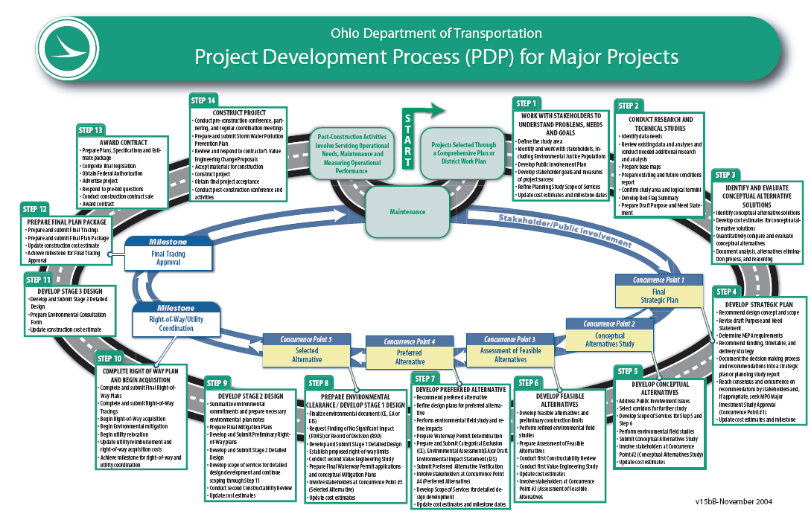
MOTAA
Stage 1 Design
MOT Policy Exception
Notes:
The goal of the MOTAA is to identify potential traffic safety and mobility problems prior to detailed design so that a solution can be engineered into the design.

Slide 8
Wisconsin DOT Lane Closure Analysis Tool
Provides earlier sense of potential delay impacts
Covers segments of the freeway/expressway statewide
Contains hourly traffic count data
Contains pre-calculated estimates of road user delay likely to occur if a lane is closed:
  Time of day
  Day of the week
  Seasons
Notes:
Goal of tool is to allow designers to get an earlier sense of potential delay impacts and therefore how to best mitigate these impacts.
LCAT covers segments of the freeway/expressway statewide and contains hourly traffic count data and pre-calculated estimates of road user delay that would likely occur if a lane were closed at particular times of day and days of week during representative time periods in the Spring, Summer, and Fall seasons.
The tool has not yet been widely used, but WisDOT is starting to train their regions on how to use the tool so that it can become a standard part of the TMP development process.

Slide 9
Maryland Lane Closure Analysis Program
Quantifies queues, delays from capacity decreases in freeway work zones
Compares demand against WZ capacity on hourly basis to estimate delay, queue
2 versions:
  Basic: Quick estimation from capacity model calibrated with MD driving behavior
  Pro: Microscopic simulation module that considers more factors (complex geometry, driver interaction with signs, traffic conditions)
Notes:
The Lane Closure Analysis Program (referred to as LCAP) was developed to provide Maryland State Highway Administration with:
An advanced model for estimating WZ capacities
In an integrated and user-friendly computer program that enables SHA engineers to analyze a variety of WZ issues, including guidelines for work zone design, and methodologies for capacity estimation, traffic impact analysis, cost/benefit evaluation, lane-closure penalty assessment, as well as incentive/disincentive estimates for various implementation plans.
LCAP comes in two versions.

Slide 10
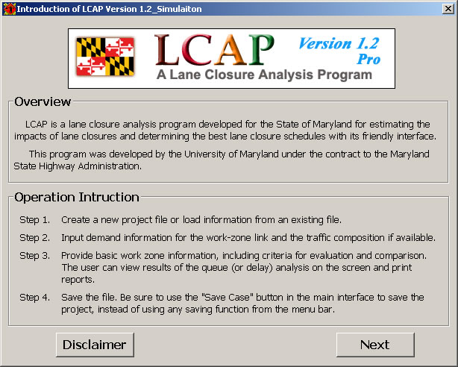
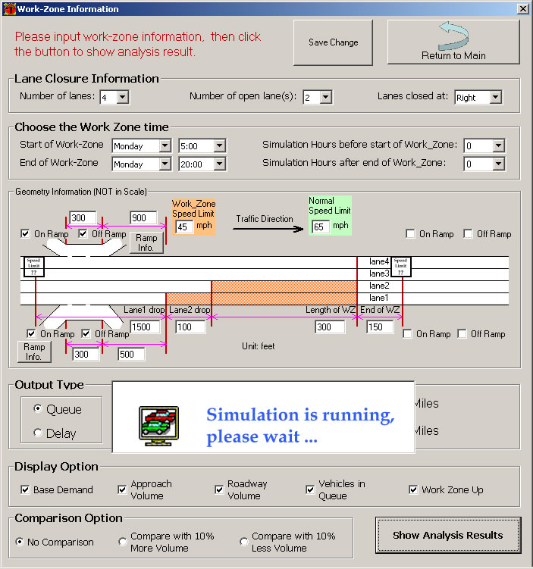
Maryland LCAP
Notes:
Program is in Microsoft Excel and consists of a four-step process:
STEP 1
Enter project information. Allows the user to input data that defines the project, such as the roadway name, direction of travel, segment of road, and work being performed.
STEP 2
Input demand. The demand is an essential part of the LCAP program. Users may enter their own data or access SHA’s traffic data from the Traffic Monitoring website.
STEP 3
Describe the work zone. The user is prompted to select input options in terms of maximum allowable queue length or maximum allowable delay (to be highlighted in red or yellow when exceeded) and proposed lane closure hours. Using trial and error in the start and finish times of the work zone, lane closure schedules can be determined based on allowable queues or delays.
Lane Closure Information—The user enters the total number of freeway lanes and the number of open lanes with the lane closure in effect.
Capacity Information—The user enters the roadway capacity without and with the work zone in vehicles per hour per lane. The work zone capacity can be determined in four ways: Engineering judgment, 1997 Highway Capacity Manual, University of Maryland Capacity Estimation equation, or 2000 Highway Capacity Manual equation.
Output Type—The user selects queue length or delay as the measure of the work zones mobility impact. The user has the option of highlighting the output in red or yellow if the queue exceeds a specified length (miles) or the delay exceeds a specified period of time (minutes).
STEP 4
Save File. LCAP has the ability to save all of the data associated with the project.

Slide 11
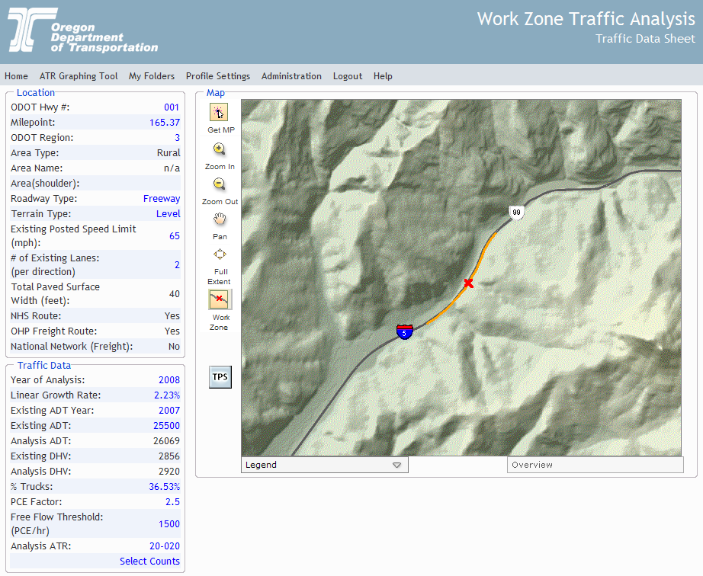
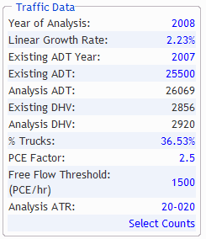
Oregon WZ Traffic Analysis Tool
Online tool:
  Estimate delay/travel time - work zone, segments, corridors
  Determine times for lane closures/work windows
  5–15 minutes per analysis
Output includes:
  Delay estimates
  Lane closure charts
  Roadway profile
  Curve and grade tables
Notes:
Oregon DOT’s Web-Based Work Zone Traffic Analysis Tool makes Oregon’s highway data available via the Internet. Available traffic data include Average Daily Traffic, average truck percentage, horizontal curve and vertical grade, and more. The tool can be used to predict hours of the day when lanes or shoulders can reasonably be closed and the approximate delay that would develop during such closures.
The location can be chosen by either:
Selecting the Highway # and milepost from a pick list
Using a GIS map to select the location.
When an engineer inputs the year of analysis for the future work zone, the tool automatically pulls in the projected traffic data.

Slide 12
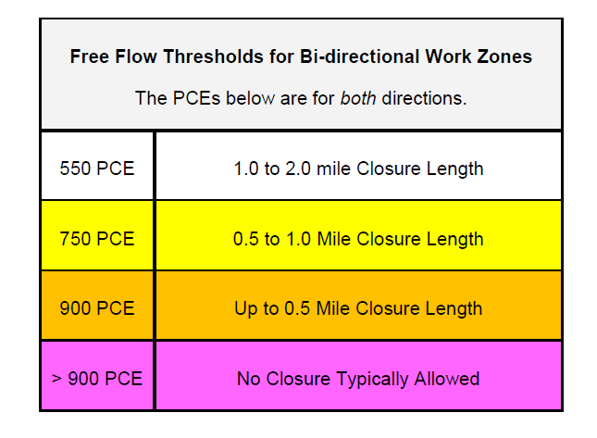
Oregon WZ Traffic Analysis Tool

Slide 13
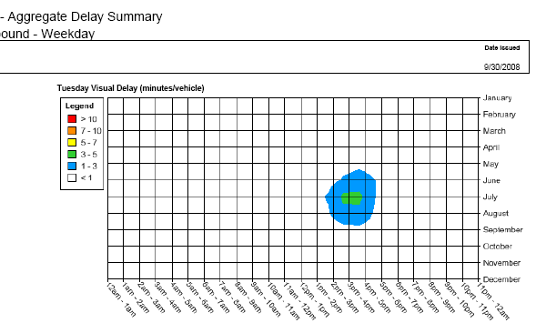
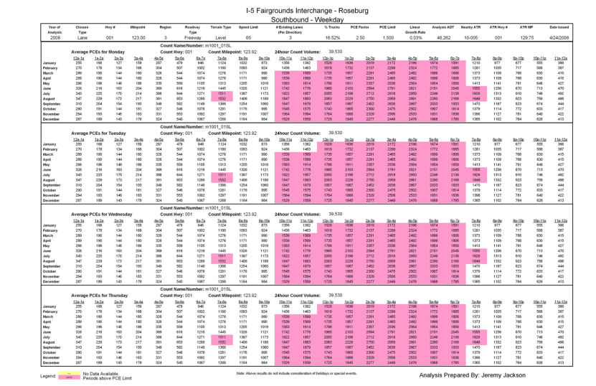
Oregon WZTA Tool
Delay summaries affect projects
  Planning: Closure chart and delay estimates influence staging strategies and scheduling
  Design: Closure information used in project specifications
  Construction: Short notice issues
Delay Estimate by WZTA
Notes:
A sample delay chart generated by the tool is shown here. The chart gives an estimate of the delay by month of year and time of day. The chart is color coded. For example, blue indicates an anticipated delay of 1-3 minutes per vehicle, and green indicates 3-5 minutes delay per vehicle.
A sample weekday lane closure chart is also shown, with the times when demand exceeds capacity shaded..
Delay summaries from Oregon’s Work Zone Traffic Analysis Tool affect scheduling and staging for major construction projects

Slide 14
Significant Projects

Slide 15
Significant Projects
Agencies now have a process in place to determine level of impacts of a project
Agencies using:
  Quantitative and/or Qualitative criteria
  Project impact levels
  Decision flowcharts
  Some combination
Notes:
90% of agencies have developed a process to determine the impact type of projects. Several agencies cited use of a process to filter out significant projects without classifying all projects based on impact type I, II, III, or IV.
One agency noted use of a checklist to classify projects using metrics such as project size, complexity, construction time, and anticipated traffic volume. The checklist results are then used to help practitioners understand the potential impacts at each stage of the project.
Some agencies noted having fewer than four classification ratings but cited a similar process for separating projects based on their level of potential impact.
One agency cited project cost as a key metric in determining whether it is significant ($5 million and higher cost).

Slide 16
Pennsylvania DOT Significant Project Determination
Based on amount of added travel time:
< 15 minutes, impacts are acceptable
>15 minutes and < 30 minutes, impacts are acceptable if for 2 consecutive hours or less
> 30 minutes, impacts are unacceptable and alternate strategies must be considered
Districts use QuickZone, Synchro, HCS or similar programs to model the expected added travel time
Notes:
The standard used to determine the impact of proposed work zones in PA is added travel time. The District may use QuickZone, Synchro, HCS or similar programs to model the expected added travel time that will be generated.
For added travel time equal to or less than 15 minutes, the work zone impacts are acceptable.
For added travel time greater than 15 minutes, but equal to or less than 30 minutes, the work zone impacts are acceptable if the added travel time exceeds 15 minutes for two consecutive hours or less.
For added travel time greater than 30 minutes for any period of time, the work zone impacts are unacceptable. Alternate strategies shall be considered per the provisions of PA’s WZ policy.

Slide 17
Michigan DOT
Significant Project Criteria
If one or more of these thresholds are exceeded, then the project is considered significant:
  Work zone delay greater than 10 minutes
  Work zone LOS is lower than or equal to LOS D, or it drops to LOS C if the current operation is LOS A
  Work zone volume/capacity ratio is greater than 0.80
Notes:
If one or more of these thresholds are exceeded, then the project is considered significant and a full transportation management plan (TMP) is required.

Slide 18
Montana DOT Significant Projects
Three levels of impacts
  Level 1 – Impact the traveling public at the metropolitan, regional, or interstate level; directly impact a large number of travelers
  Level 2 - Impact the traveling public at the city or regional level; directly impact a moderate level of travelers
  Level 3 - Impact the traveling public to a small degree; duration of work is short to moderate
All Level 1 projects are significant
Policy includes a list of corridors in MT that are automatically Level 1 and Level 2
Policy includes significant project identification checklist
Notes:
WZ Policy includes criteria for determining whether or not a project is considered significant.
All projects identified as Level 1 impact are considered significant projects. These projects typically impact the traveling public at the metropolitan, regional, or interstate level; have a high level of public interest; directly impact a large number of travelers; have high user cost impacts; and are of long duration.
Level 2 projects impact the traveling public at the city or regional level; have a moderate level of public interest; directly impact a moderate level of travelers; have low to moderate user cost impacts; and can include lane closures for a moderate duration if not during peak hours.
Level 3 projects impact the traveling public to a small degree; public interest is low and AADT is low; duration of work is short to moderate; construction zones can be mobile; and typically this work is recurring (such as mowing, pothole patching, etc.).
Policy includes a list of corridors in Montana that are automatically of Level 1 and Level 2 significance. It also includes a checklist to help identify significant projects.
Checklist:
IF Through-lane closures for more than 3 continuous days; AND/OR Through-lane closures during morning, lunch time or evening peak directional traffic flow periods for more than 3 continuous days; AND/OR Impair critical movements at a major intersection for more than a 3-consecutive day period
And one of the following:
On Level 1 corridor list OR Principal arterial within an urban area
Or other triggers for significant projects apply (several triggers listed)
THEN this project is considered a Significant Project for Work Zone Safety and Mobility purposes.

Slide 19
Tennessee DOT Significant Project Determination
Notes:
Described in Part 3 of the TDOT Work Zone Safety and Mobility Manual
Manual states, “It should be noted that if a project is determined to be Significant, it does not necessarily mean that the development of the TMP will be a time-consuming or exhausting effort. If a project is determined to be Significant, it simply means that additional mitigation strategies should be implemented to reduce congestion and improve safety within the work zone. Often, these strategies are things that TDOT is already doing for many work zones.
TDOT defines a significant project as:
Any project on the interstate system located within a recognized Transportation Management Area (TMA) that occupies a given location for at least three days duration with either continuous or intermittent lane closures.
(b) Any project of any duration on an interstate route or any route with an AADT of at least 50,000 vehicles per day for which all lanes in one direction will be closed to traffic.
(c) Any project for which the delay through the limits of the work zone is at least 30 minutes above the normal delay under typical non-work conditions. (Using the delay criteria reference table in the WZ Safety and Mobility Manual).
(d) Any project deemed Significant by extraordinary qualitative characteristics. This determination may be made on the basis of conditions such as high levels of public interest, business/community impacts, or long work zone duration. All Significant Projects defined in this manner shall only be done with careful consideration and strategic decision making.
In reference to the definition above, items (a) and (b) are presented as Major Route Criteria, item (c) defines the Delay Criteria, and item (d) defines the Qualitative Criteria.

Slide 20
Transportation
Management Plans (TMPs)

Slide 21
How Do States Develop TMPs?
“If you have a really good systematic process in place, and have developed checklists, guidance, and other materials to help facilitate this process, then you are less likely to miss steps in your TMP development and are less likely to leave important components out of the TMP.”
- MD SHA Team Leader, Traffic Policy and Management Team
Resource | States
Templates | PA, RI, MI, TN
Guidelines | CA, MD, MI, NC, NJ, OR, VA, WI
Training | CA, FL, MO, NC, RI, MI, WI
Notes:
Many agencies credit TMP training, guidelines, and templates as the key factor in institutionalizing the TMP development process and facilitating uniform documentation of their TMPs.
A number of agencies have developed TMP guidance, training, resources; this table shows a sampling of these agencies and the types of TMP resources available.
Several States used FHWA's publication Developing and Implementing Transportation Management Plans for Work Zones in developing their own processes and guidance.
Michael Paylor, MD SHA Team Leader of the Traffic Policy and Management Team, “What an agency includes in its TMP guidelines may look good on paper, but can only be effective if the guidelines are implemented in the way that is intended.”
Julie Johnston, Michigan DOT Work Zone Delivery Engineer, “The guidelines and templates also need to take into account that projects vary in complexity and therefore the template and guidelines need to be flexible to accommodate different types of projects.”

Slide 22

Caltrans TMP Levels
Notes:
Caltrans TMPs are categorized into three types based on project characteristics and projected delay: Blanket TMP, Minor TMP, and Major TMP. This slide lists the types of conditions and possible strategies for each of these three TMP categories. A Blanket TMP is a standard set of actions taken to minimize delay when performing maintenance activities or projects. Minor TMPs are used for improvement projects when minimal impacts are expected (e.g., night-time construction). Major TMPs are implemented for projects where significant traffic impacts are anticipated and multiple TMP strategies are required to manage impacts.
Caltrans places TMP strategies into 6 categories:
Public information
Motorist information
Incident management
Construction strategies
Demand management
Alternate routes

Slide 23
Wisconsin DOT TMP Guidance
Helps WisDOT develop and implement TMPs effectively and consistently statewide
TMP worksheet/checklist
Developing benefit-cost guidelines for WZ impacts mitigation strategies
Notes:
Have established guidelines for developing TMPs for all highway construction, street maintenance, and utility or construction activities performed by WisDOT, municipalities, and other agencies. The intent of these guidelines is to assist regional planners, traffic engineers, and designers in developing TMPs for work zones and to help WisDOT develop and implement TMPs effectively and consistently statewide to enhance safety and mobility while minimizing delays caused by construction work zones.
TMP worksheet provides a checklist of items that need to be considered in developing TMP, documents project information, planned staging for maintaining traffic, lane closure info, detour, how to coordinate with special events to minimize traffic disruptions, analysis of traffic and capacity to estimate travel time and delay impacts, identification of mitigation strategies, public information strategies, incident management strategies, adjacent projects affected by this work.
Looking into putting this worksheet into an online format so that it can be filled out online and stored and archived online, then TMPs for all projects could be viewed by anyone to use to help in development of other TMPs and to coordinate adjacent projects.
Benefit-Cost guidelines - will help engineers select the best work zone impacts mitigation strategies for a project, given constraints such as site conditions and budget. Will help engineers compare the benefits of reduced road user delay to the cost of alternative mitigation strategies in order to select the most cost-effective strategies during the TMP development process.

Slide 24
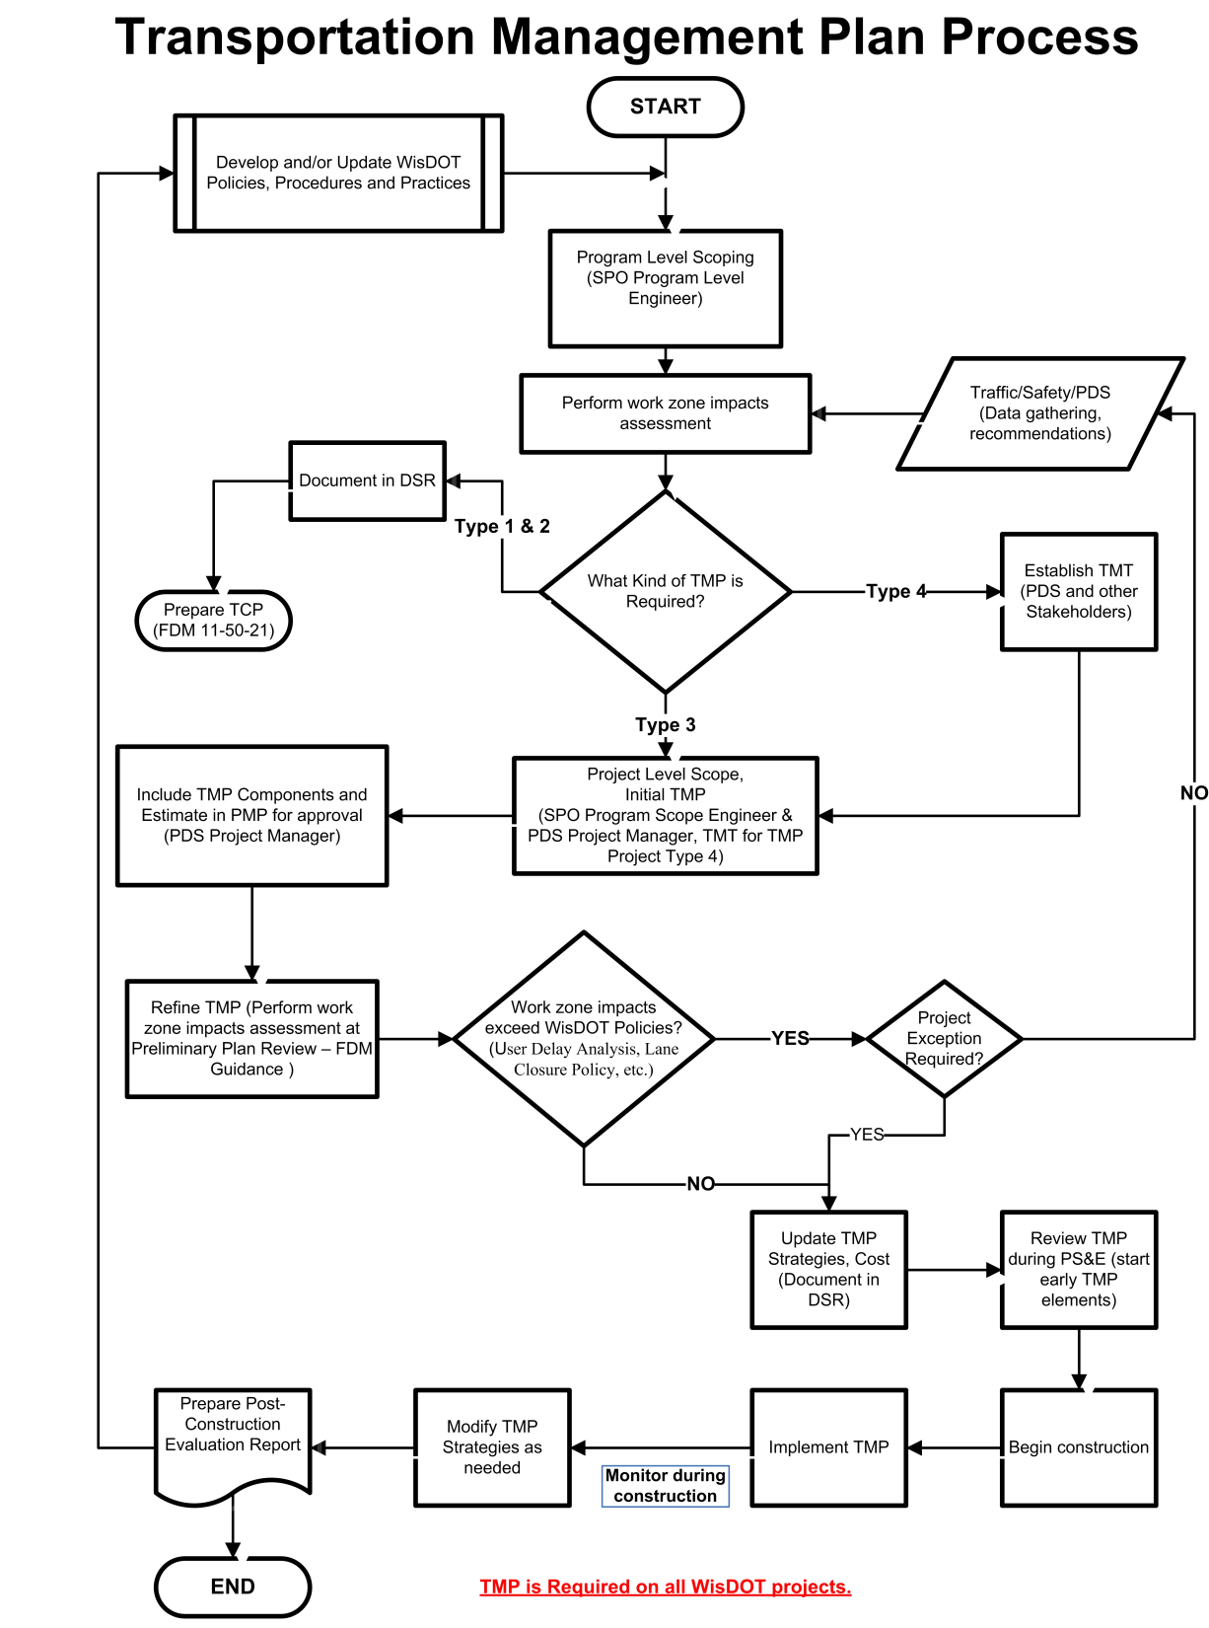

WisDOT
TMP
Process
Notes:
Wisconsin DOT does a systematic assessment of work zone impacts for construction projects that affect travel lanes. They categorize TMPs into four different types, with types 3 and 4 being significant.
At the program level-scoping phase, a preliminary work zone impact assessment is conducted to determine the type of TMP. A preliminary TMP is prepared at this stage.
During the preliminary plan review stage, work zone impacts are re-assessed for type 3 and type 4 TMPs using formalized guidance called Lane Closure and Delay Guidelines. If the impacts are determined to be within Wisconsin DOT policies, TMP update and implementation continues. If the impacts are determined to exceed Wisconsin DOT policies and a project exception is not approved, the TMP strategies are revised and impacts are re-assessed. The goal is to mitigate to the greatest extent possible, safety and mobility impacts to workers and the public.

Slide 25
Michigan TMP Review Teams
Sample Review Checklist Questions:
Traffic analysis methodology is appropriate and reasonable for the scope/complexity of the job/location and the results are clear and understandable.
There is analysis of the alternatives considered, with an appropriate comparison of benefits and costs.
There is adequate discussion and explanation of corridor impacts and/or an explanation of mobility influences beyond the project area including adjacent regions.
Used when a project is designed that exceeds significant project thresholds
TMP is reviewed against a checklist
Peer review team meets to discuss and rate TMPs:
  Green
  Yellow
  Red
Notes:
MDOT Systems Operation and Management Engineer creates a peer review team to review all submitted projects against a review checklist.
Projects are submitted to the peer review team after the Plan Review (at the 35 percent design stage) and before the errors and omissions check (design is almost final). At this point the TMP is mostly complete but there is still some flexibility in design and budget.
In order to assist Regions with TMP development and to ensure TMPs include consistent information across all Regions, MDOT created a TMP template that describes what should be included in the TMP.
Team members are independent of the Region that submits the TMP for review.
TMPs are rated:
Green - Go ahead with the project.
Yellow - Some issues need to be reviewed and changes considered. If any changes are made, the local office is asked to submit a document stating what changes were incorporated.
Red - There are potential show stoppers and some elements of the project may need to be revised before moving forward. This category is also for projects that have not yet completed the design phase or TMP development, or information was missing during the TMP review.
In addition to improving the TMP, the peer review team process is a mechanism to share ideas and best practices. In some cases personnel on the peer review team find that other regions are implementing good ideas that they had not previously considered.

Slide 26
Data Collection and Analysis and
Performance Monitoring
Notes:
Data Collection and Analysis is closely related to performance monitoring and conducting work zone process reviews, as data is necessary to understand how work zones are performing and where changes in processes may be needed.

Slide 27
Ohio DOT Data Collection, Analysis, and Performance Monitoring
Historic Crash Data
  Used to track improvements to WZ safety
Near Real-Time Crash Data
  Obtained from local law enforcement
  Stored in database
Real Time Mobility/Speed Data
  Leasing speed & travel time information
  Contract advertised and awarded (low bid) separately from the construction project
Real-Time Mobility Data Example:
  8 mile work zone
  Sensor spacing ½ mile in transition area and 1 mile in work area
  Approximately 10 sensors covers both directions
  Cost = $1,100/mo
  Gives real time data via cellular broadband
  Can be used internally or externally via the web
Notes:
In 2004 ODOT developed a process to monitor work zone crashes in near real-time. ODOT obtains work zone crash reports in near real-time from local law enforcement and then inputs this information into a database that sorts crashes into one half mile segments for comparison to historical pre-construction average crash frequency. When ODOT finds abnormally high concentrations of crashes in a certain location after implementation of a work zone, ODOT performs a field visit to the construction area to look for causes and potential fixes.

Slide 28
Ohio DOT WZ Crash Data Analysis
Began in 2002
See if increased number of WZs causes more crashes and how they could be prevented
Used data from prior to and during construction to perform before/after comparison
Findings led to improvements to WZ planning and design procedures
Notes:
In 2002, the Ohio Department of Transportation (ODOT) embarked on a data analysis effort to determine if an increased number of work zones was causing more crashes, and if so, what could be done to prevent the increase in crashes. Using data collected during construction and prior to construction, ODOT performed a before/after comparison of crash rates on major Interstate work zones. Based on the findings of this analysis, ODOT was able to make several improvements to its work zone planning and design procedures.

Slide 29
Ohio DOT Historic Crash Data Analysis
Notes:
Tells how they are doing with safety.

Slide 30
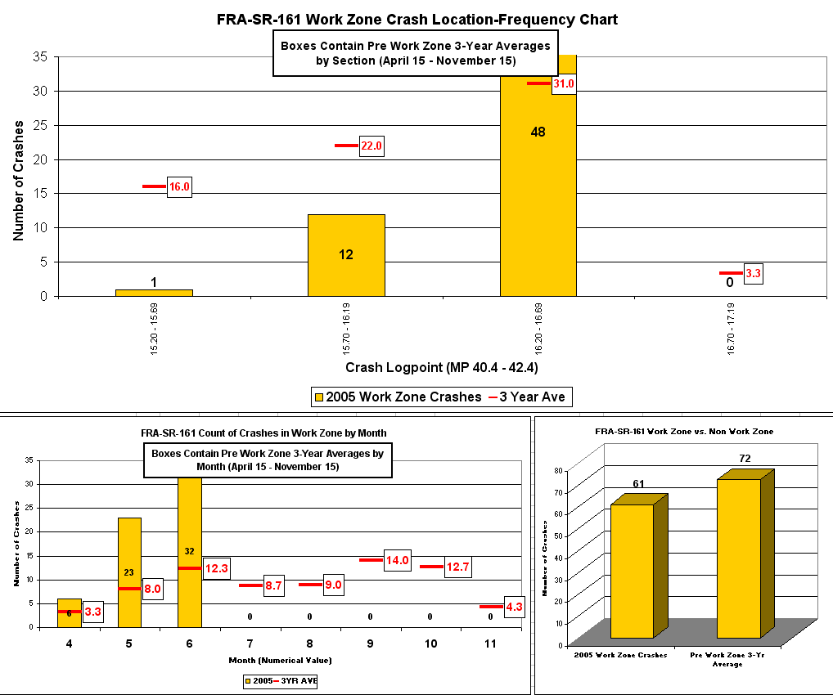
Ohio DOT Near Real-Time Crash Data Analysis
Mile 16.2 – 16.99
Non WZ 7 Month Avg.
WZ 3 Month Total
BIG PROBLEM !!

Slide 31
Michigan DOT Data Collection, Analysis, and Performance Monitoring
Monitoring plan included in TMP for significant projects
  Includes crash analysis before and after project
Weekly monitoring
  WZ delay and queue measurements taken by sensor, field staff observations, and drive-throughs by student interns
Monitoring forms stored in project records system and can be referenced for future projects
Delay and queue data entered into database for periodic analysis
Notes:
Includes a monitoring plan in its TMPs for significant projects. The monitoring plan includes a crash analysis of before and after a project is done and makes comparisons with another similar work zone.
Work zone delay and queue measurements are done by staff in each region using a combination of a portable trailer with a sensor, field staff observations, and work zone drive-throughs by student interns.
The monitoring initially occurs weekly during peak and off-peak periods, with the frequency reduced if conditions are stable.
The Region submits completed monitoring forms to MDOT’s project records system where designers can reference them for future projects.
Delay and queue data are also entered into a database for periodic analysis.
In 2009, MDOT’s work zone monitoring showed that the majority of projects either met or exceeded their goal of having less than a 10 minute delay.

Slide 32
Michigan DOT Mobility Data Collection
Determined through real-time measurement of vehicle speeds
Regions collect data but not told how to do it
Mobility data must be recorded in a Delay Worksheet
Data used to evaluate project and program-level effectiveness
  First year – 88% of projects met MDOT’s 10-minute delay criteria
Notes:
Some MDOT Regions have purchased trailers to take measurements, while other Regions have purchased cameras that allow work zones to be monitored online. Some Regions have purchased detection equipment (without a camera) to measure vehicle speed and occupancy. This equipment hooks up to a pickup truck and can be left out for a few days to monitor a work zone. Several local MDOT offices have purchased monitoring equipment, have obtained extra co-op assistance to help with data collection, and/or have driven work zones to measure queues and record delay time. The MDOT Central Office would like Regions to collect the information but they do not prescribe how to do it.
Each region is responsible for updating and maintaining the delay worksheet along with any supplemental information needed for their projects. The information contained in the Delay Worksheet will be utilized for evaluating project and program level effectiveness.

Slide 33
Coordinating Multiple Projects

Slide 34
Coordinating Multiple Projects
Planning and impacts assessment at corridor/network/regional level
Scheduling/Sequencing
Optimizing letting schedule so that multiple projects do not excessively impact traffic
Inter- and intra-agency coordination to avoid traffic impacts on 2 parallel routes at same time
Possible cost-sharing of mitigation strategies
Planning process plays key role to coordinate concurrent projects and when a project has potential to cause corridor-wide impacts
Notes:
49% of agencies said the Rule has caused them to expand planning and impacts assessment beyond the project WZ itself to address corridor, network, and regional issues as a result of the Rule.
92% of agencies are minimizing disruptions on major traffic corridors by optimizing the letting schedule. Projects are reviewed to make sure that multiple projects do not adversely impact traffic along certain corridors. One agency noted that development of TMPs has helped the agency focus on processes and techniques such as altering letting schedules to avoid major impacts
A corridor-wide approach to planning for construction projects can alleviate impacts at a larger than normal scale and can optimize traffic flow on the mainline and alternate routes during construction. This approach requires adequate coordination and communication between federal, state, and local agencies – coordination across boundaries that may require extra effort outside the normal mission and associated procedures within each agency.
Management of construction impacts at the “Program” level as opposed to the “Project” level introduces coordination and communication needs early into the process. Typically, sensationally large projects often attract attention and require enhanced coordination with agencies in adjacent jurisdictions due to a high probability of impacts. Generally, DOTs may share information through state- level coordinators (such as MPO coordinators) on large, potentially high impact projects, but centralized construction program information repositories are less common.
Enhanced coordination can include a larger than-local area so that corridor- level or regional impacts can be better understood and managed. There are areas where coordination initiatives can enhance the process throughout the course of project development. For example, in the planning stages, agencies may use their historical knowledge to identify anticipated traffic impacts based on the magnitude of projects and brainstorm ideas for treatments and strategies to mitigate impacts. In the preliminary and final design stages of a project, agencies may have performed some type of analysis (e.g., capacity, simulation, etc.) based on more detailed data and have developed a better understanding of how traffic control plans and lane restrictions may impact traffic. Combined with a coordination group, both strategies can be beneficial.
For agencies that lack the support to form an internal/external working group to reach out to stakeholders, momentum will need to be generated to form a voluntary consortium to meet regularly to discuss potential impacts and, overall, provide enhanced communication and coordination. This course of action will minimize the possibility of large-scale impacts along a corridor if project scheduling consensus can be met among stakeholders.

Slide 35
Coordinating Multiple Projects: Minnesota DOT
WZ Policy includes:
  Worksheet to help identify project impacts and potential mitigation strategies
Worksheet includes focus on Corridor, Network, and Community Issues:
  Includes impacts of other work zones in the vicinity of the project, either at the corridor level or the network level.
Management Strategies
  Includes section on Project Coordination
Notes:
Corridor, Network and Community Issues also includes:
Impacts on nearby transportation infrastructure such as key intersections and interchanges, railroad crossings, public transit junctions, and other junctions in the transportation network.
• Impacts on evacuation routes in the vicinity of critical transportation or other infrastructure.
• Impacts on affected public properties, including parks, recreational facilities, fire stations, police stations, and hospitals.
• Impacts of the project on affected private properties, including businesses and residences.
Listing of management strategies is taken from FHWA’s Implementing the Rule on Work Zone Safety and Mobility. Project coordination includes:
Coordination with other projects
Utilities coordination
Right-of-way coordination
Coordination with other transportation infrastructure

Slide 36
Coordinating Multiple Projects: Utah DOT
Traffic Management Committee
Traffic Management System
Weekly construction coordination meetings (April – October)
Notes:
Traffic Management Committee: In 2001, the Utah Legislature established a Traffic Management Committee.
Committee members include UDOT, Utah Association of Counties, Dept of Environmental Quality, Wasatch Front Regional Council, Dept of Public Safety, Mountainland Association of Governments, Utah League of Cities and Towns, Utah Transit Authority.
Committee is to make recommendations and provide guidance to UDOT, counties, and municipalities on enhancing safety and efficiency of highways using strategies such as traffic signal coordination, monitoring, ramp metering, variable message signing, and incident management.
Traffic Management System: The 2001 legislation mandated implementation and administration of a traffic management system to improve regional mobility and to allow for information sharing across agency boundaries.
Weekly Construction Coordination Meetings:
Meetings are held on Thursday mornings and discussion focuses on upcoming construction-related traffic impacts for the weekend through the next week.
During these meetings major traffic control changes and upcoming closures are discussed 2 to 3 weeks out so that any coordination between projects can take place.
Conflicting traffic control plans, estimated impacts, and potential detour routes are identified and adjusted as needed.
Typical participants in weekly construction coordination meetings are 6 resident construction engineers, the two regional public information coordinators, Traffic Operations Center (TOC) control room supervisors, signal coordination engineer, a meteorologist, 2 regional traffic engineers, a permits office representative, and the regional maintenance area supervisors.

Slide 37
Utah DOT WZ Program Planning
Program-level traffic analysis framework
Facilitates implementation of construction programs
  Timing and scheduling of multiple construction projects at system level
  Operational treatments during construction to alleviate impacts
Traffic data from MPO
Early analysis results help with decisions as early as possible
Notes:
UDOT uses a program-level traffic analysis framework called "User Impact Planning" to help facilitate implementation of construction programs and to help determine operational treatments during construction to alleviate impacts.
Modeling helps UDOT better understand future operational characteristics and allows for enhanced planning activities. The UDOT modeling program helps decision-makers determine the timing for multiple construction projects at the system level and helps with scheduling decisions and letting timeframes.
The UDOT process includes three stages, where the second stage involves planning level analysis to evaluate three alternatives - no build, traditional build, and fast track design-build. The analysis at this level includes quantitative estimates of measures of effectiveness including total vehicle hours of delay per alternative.

Slide 38
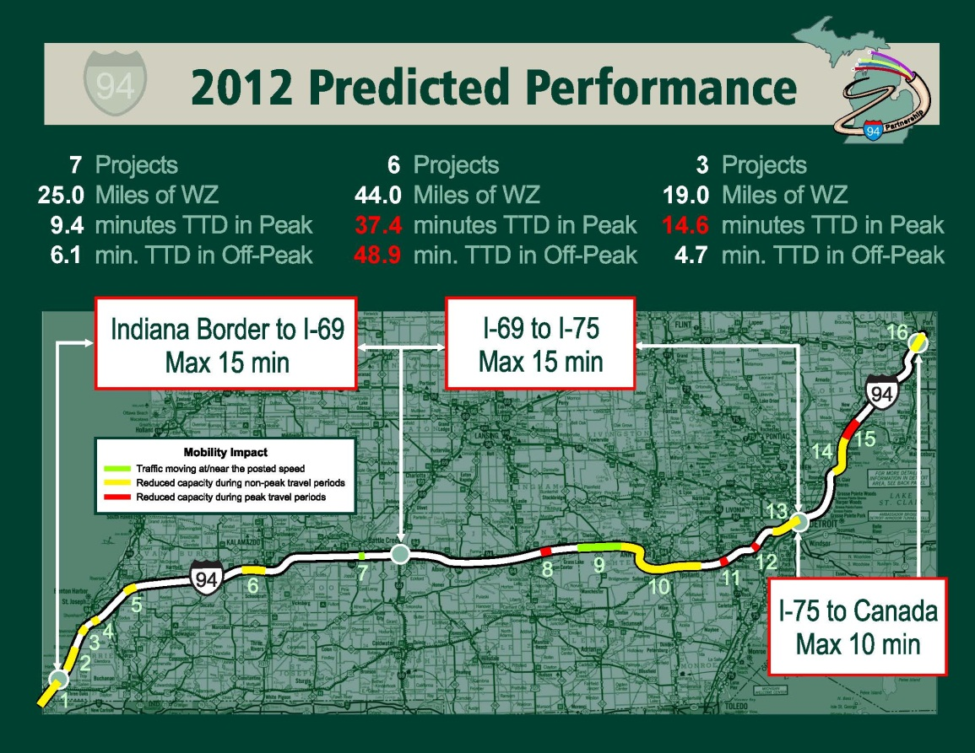
Coordinating Multiple Projects: Great Lakes Regional Transportation Operations Coalition
Annual WZ preview
Online WZ map
I-94 demonstration corridor
Conference calls
Notes:
Founded in 2009 to improve cross-regional transportation operations for regional economic competitiveness and improved quality of life. Members are agencies that have transportation operations on the major routes connecting Minneapolis to Toronto: Illinois DOT, Illinois State Toll Highway Authority, Indiana DOT, Indiana Toll Road Concession Company, Michigan DOT, Ministry of Transportation Ontario, Minnesota DOT, Skyway Concession Company, and Wisconsin DOT.
Work Zone efforts:
Annual WZ preview: The effort started with the annual work zone preview to discuss upcoming projects to increase awareness of neighboring work zones and identify opportunities for adjustments or remediation.
Online WZ map: Work zones are overlaid on an interactive Google map and color coded by impact estimates. They are enhancing the map to allow users who are logged in to modify, add, or remove work zones throughout the year to become more proactive in coordination.
I-94 Demonstration Corridor: On this key corridor the Coalition established tolerable travel time delay for work zones along the entire corridor and improved multi-agency work zone performance monitoring.
Bi-weekly Conference Call: Construction engineers participate in bi-weekly conference calls to discuss the status of and coordination issues with their projects, which has resulted in sharing better ideas in regard to progress clause requirements and construction best practices, such as standardizing construction signs and traffic control.
Other work zone collaboration/coordination efforts:
Comparison of how agencies estimate work zone impacts, or in terms of the FHWA's Work Zone Safety and Mobility Rule, how agencies define "significant." This entails many variables and enormous variation among agencies.

Slide 39
Oregon DOT Corridor-Level TMPs
Serve as framework for corridor management
Apply to all projects combined in the corridor
Define delay thresholds for each corridor
  If anticipated corridor delay > threshold ➔
  Review project schedules, staging, and traffic management strategies to try to reduce delays
Notes:
Corridor-Level TMP. Corridor-Level TMPs were developed for specific key freight and travel routes and address corridor management (including communication, coordination, and implementation), bridge construction scheduling and staging, and WZ traffic operations strategies at the corridor level. Corridor-Level TMPs have been developed for each of 6 identified corridors as part of the OTIA program.
The primary purpose of Corridor-Level TMPs is to serve as the framework for corridor management and not to address all of the specific activities that may be required during the course of a project. Such activities are addressed within the Project-Level TMPs.
The Corridor-Level TMPs define delay thresholds for each corridor. These thresholds apply to all projects combined in the corridor.
Project and corridor delay are estimated using ODOT's WZ analysis tool. The calculated delay thresholds are an attempt to quantify the maximum delay that would be considered tolerable by the traveling public as a result of construction activities throughout the corridor. If the corridor delay threshold would be exceeded, a review of project schedules, staging, and traffic management strategies (like public information) will be conducted to determine if, and at what cost, the delays associated with the projects can be reduced.

