Slide 1
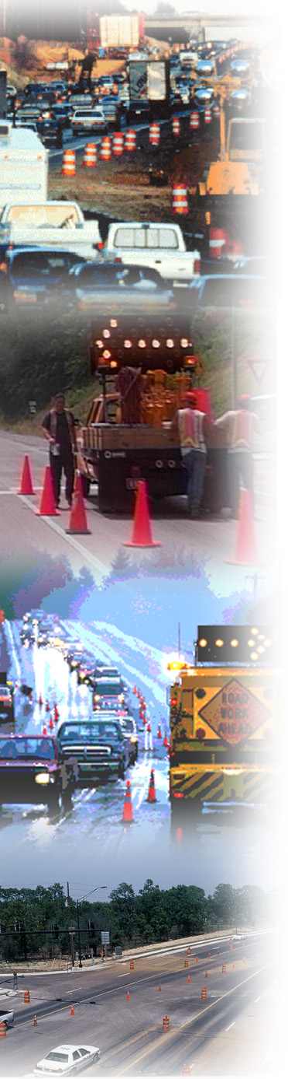

Transportation Management Plan Overview
Module 3

Slide 2
What is a TMP?
Transportation Management Plan
Set of coordinated strategies implemented to manage WZ impacts of a project
Scale-able – projects with more expected impacts may need more analysis and more strategies
Notes:
One of the goals of the updated Rule is to expand WZ impacts management beyond traffic control. Using scheduling, construction strategies, contracting strategies, transportation management strategies helps to improve safety, reduce traffic and mobility impacts, and promote coordination in and around the work zone. To encourage this broader thinking, one of the components of the updated Rule expands the existing requirement for developing a traffic control plan (TCP) for handling traffic at each work zone to now require the development and implementation of a transportation management plan (TMP) for road project.
TMPs present a more comprehensive approach to managing work zone safety and mobility. A TMP lays out a set of coordinated work zone management strategies and describes how they will be used to manage the work zone safety and mobility impacts of a road project. Transportation management strategies for a work zone include temporary traffic control measures and devices, operational strategies, and public information and outreach. WZ ITS can be used as an operational strategy and can be used for public information and outreach.

Slide 3
TMP vs. TCP
TCP – plan for handling traffic through the use of traffic control devices
  Once strategy is determined, TCP implements
TMP – more comprehensive - incorporates broader issues
  Public awareness
  Mobility and safety impacts
  Network and demand management
  Stakeholder involvement

Slide 4
What is a TMP?
Design documents - how you are going to build a project
TMP - how you are going to manage transportation needs during a project
With today’s WZ challenges, a TTC plan may not be enough

Slide 5
TMPs are a Tool
Part of overall WZ management
Effective WZ management requires:
Understanding the likely impacts of a WZ
  Safety and mobility
Choosing a combination of strategies
  To address the impacts for that project
Implementing those strategies
The TMP outlines all that for a project
Notes:
Effective WZ management requires a combination of strategies. The best combination of work zone management strategies needs to be based on site-specific conditions and thus determined on a case-by-case basis.
The scope, content, and level of detail of a TMP should vary based on the agency’s work zone policy and the anticipated work zone impacts of the project.

Slide 6
TMP Strategies to Manage Work Zone Impacts
Temporary Traffic Control (TTC) Strategies | Public Information (PI) Strategies | Transportation Operations (TO) Strategies
-Traffic control/design approaches -Traffic control devices -Project coordination, contracting, and innovative construction | -Public awareness -Motorist information | -Demand management -Corridor/network management -WZ safety management -Traffic/incident management & enforcement -Off site improvements
Notes:
Traffic Control Approaches
IA1. Construction phasing/staging
IA2. Full roadway closures
IA3. Lane shifts or closures
Reduced lane widths to maintain number of lanes (constriction)
Lane closures to provide worker safety
Reduced shoulder width to maintain number of lanes
Shoulder closures to provide worker safety
Lane shift to shoulder/median to maintain number of lanes
IA4. One-lane, two-way operation
IA5. Two-way traffic on one side of divided facility (crossover)
IA6. Reversible lanes
IA7. Ramp closures/relocation
IA8. Freeway-to-freeway interchange closures
IA9. Night work
IA10. Weekend work
IA11. Work hour restrictions for peak travel
IA12. Pedestrian/bicycle access improvements
IA13. Business access improvements
IA14. Off-site detours/use of alternate routes

Slide 7
Potential TMP Components
Introductory material
Executive Summary
TMP Roles and Responsibilities
Project Description
Existing and Future Conditions
Work Zone Impacts Assessment

Slide 8
Potential TMP Components (con’t)
Work Zone Traffic Management Strategies
  TTC Plan
  Traffic Operations Plan
  Public Information Campaign
TMP Monitoring Requirements
Contingency Plans
Implementation Costs

Slide 9
TMP Formats
TMPs need to be documented
Options include:
  Single document with all included material
  Brief document with summaries of analysis results and decisions, where the full documentation is in the project files or similar
  Powerpoint format has been used
  Others?
Scope, content, level of detail may vary based on DOT policy and impacts

Slide 10
Why TMPs?
WZ management is increasingly complex
  Increasing traffic volumes using the same roads that agencies need to maintain and rehabilitate
  Requires traffic management efforts beyond TTC plans
Key issues:
  Safety
  Mobility
  Constructability
Objective: Achieve constructability without compromising safety and mobility
Notes:
Traffic management efforts beyond temporary traffic control (TTC) plans are needed to deal with the increasing traffic volumes using the same roads on which agencies need to perform maintenance and rehabilitation
Safety, mobility, and constructability are the three critical work zone related issues that need to be addressed while planning, designing, and building road projects.
Constructability can be defined as the optimum use of construction knowledge and experience in planning, design, procurement, and field operations to achieve overall project objectives. The objective of constructability is to facilitate rational bids and minimize problems during construction.
Benefits of constructability include cost reduction, schedule adherence, higher productivity, enhanced quality, and more safety and convenience for the traveling public.
Constructability reviews are performed to facilitate the practicality of construction and minimize project delays, changes, and costs, while at the same time maximizing productivity, quality, safety, and convenience.

Slide 11
Importance of a TMP
What are the benefits of having a well
thought-out approach to managing traffic
during a construction project?
Consider your stakeholders:
  Contractors
  Motorists
  Property owners
  Project owners
  Businesses
  Environment
  Event organizers, etc.
Notes:
The major differences between a TMA and a TCP is that the TCP focuses on the maintenance and protection of traffic within the construction zone; the TMA addresses project-related impacts throughout the project corridor and sometimes beyond. The TMA will include a preferred traffic
control method. In general, the designer will be responsible for incorporating the TMA objectives into the TCP.
GROUP EXERCISE: Ask the audience what they believe the benefits of good traffic management might be for various stakeholders during a construction project. List their answers on flipcharts/whiteboard. Compare their list to the following slide’s list.

Slide 12
Why TMPs? – Key Benefits
A well-planned method for managing traffic flow during construction can:
Promote efficient and effective construction phasing and staging, minimize contract duration, and control costs
Improve safety for workers and road users
Minimize traffic and mobility impacts
Address impacts at corridor and network levels

Slide 13
Why TMPs? – Key Benefits (cont.)
A well-planned method for managing traffic flow during construction can:
Minimize:
  Circulation, access, and mobility impacts to local communities and businesses
  Complaints from road users, businesses, and communities
Improve:
  Intra- and inter-agency coordination
  Improve public awareness

Slide 14
Why TMPs? – Key Benefits (cont.)
Better documentation of analysis and mitigation of impacts
Better coordination and scheduling of projects
More basis for reviewing MOT changes requested by the contractor
Notes:
State DOT representatives from MD, MI, OR, RI, and WI unanimously agreed that they have seen a positive change in the way WZ impacts are assessed and managed as a result of their TMPs. As a result of assessing impacts earlier in the project development agencies are able to include the cost of mitigating the impacts in their design plans.
What was initially thought to be the biggest burden and challenge about TMP development – the extra time and cost involved with documenting their plan – is now considered to be one of the greatest benefits of the TMP development process. Because many projects can take months, even years to develop, there is the likelihood that design or project lead staff may change hands. If design and development decisions are well documented, time, energy and money can be saved in the development of the project. Additionally, a developed project may sit on a shelf for months, even years, waiting for construction funding. Having these development decisions recorded aids in the ability to refresh the minds of those picking the project up after a long delay. Construction offices will benefit by having thorough, well-documented justification for why a particular alternative(s), method(s) or material was rejected should it be proposed by their contractor during construction.
The TMP development process can also enable better coordination and scheduling of projects by bringing all stakeholders to the TMP development table early on in the process and identifying impacts and mitigation strategies that reach beyond the immediate work zone area.
States appreciate having a formalized process, as it allows them to streamline TMP development across the agency, make sure the right stakeholders are included, develop more comprehensive TMPs, and better plan future projects by using the documented successful strategies from previous projects.

Slide 15
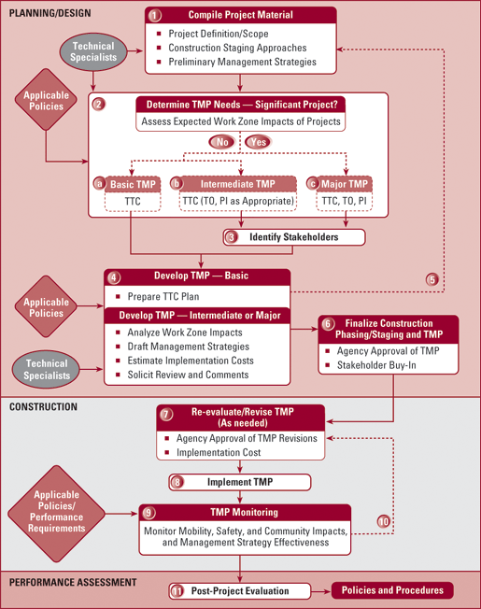
TMP Development Process
(from Developing and Implementing TMPs for Work Zones)
Notes:
This a general TMP development process diagram that may be used as a starting point for agencies to consider when developing TMP procedures and TMPs for specific projects. The example process in this figure shows three types of TMPs (Basic, Intermediate, and Major). Agencies may elect to develop a different number of categories of TMPs than what is described here.

Slide 16
When is a TMP Developed?
TMP development should begin early and progress throughout
Systems planning and preliminary engineering
  Include TMP development and implementation costs in project budget
Design
  Consider WZ impacts in evaluation and selection of design alternatives
  May be possible to choose a design alternative that alleviates many WZ impacts
  Complete TMP development
Notes:
Although a full TMP document is not developed until design, conducting some TMP analyses during systems planning and preliminary engineering will help ensure that the TMP development and implementation costs are included in the project budget. At this early stage, more alternatives for addressing work zone impacts are available, so a broader range of strategies can be chosen. Early TMP development will also help with scheduling and coordinating projects to minimize the cumulative work zone impacts of multiple projects along a corridor or in a region. This includes examining the adequacy of detour or alternate routes and coordinating with the agencies responsible for those routes.
Another strategy available in the earlier stages of project development is to consider work zone impacts in the evaluation and selection of design alternatives. For some projects it may be possible to choose a design alternative that alleviates many work zone impacts.
These broader strategies cross various disciplines and highlight the need for a multidisciplinary approach.
Of Course: Through Value Engineering or Pre-Construction meeting, changes in the project plans could occur that mean adjustments to the TMP are needed.

Slide 17
During Design…
Final assessment of WZ impacts is done, which should affect the choice of:
  Best construction/staging option(s)
  Most suitable design and contracting approach
  Most appropriate WZ traffic management strategies
Notes:
Design-level work zone impacts assessment may include consideration of corridor and network level impacts, coordination with other projects, addressing work zone impacts issues in conjunction with the project design and construction approaches, work zone transportation management, and development of TMPs.

Slide 18
TMPs Need to Be…
Well-thought out
Started early in project development
Use a multi-disciplinary approach
Coordinated with other projects nearby
Contain a combination of strategies
Fit the expected level of WZ impacts
Funded
Updated as needed after project award
Implemented!
Monitored – and adjusted as needed

Slide 19
Key TMP Development Questions
Was a TMP developed for the project?
Does the TMP consider the expected impacts of the project?
Did the agency determine if this is a significant project?
Does the TMP contain strategies to manage the identified impacts?
Are the strategies reasonable for the level of expected impacts?

Slide 20
Key TMP Development Questions (cont.)
Were key stakeholders involved?
Is implementation of the TMP funded?
Has a responsible person been designated for the DOT?
Has the DOT approved the TMP per its policies/procedures?
Are the relevant parts included in the bid package?

Slide 21
TMP Resources
WZ Safety and Mobility Rule Web Site
  Example TMPs, development resources
Developing and Implementing TMPs for Work Zones
  Includes a TMP Checklist and matrix of strategies
Templates and Samples
Online Training
FHWA
www.ops.fhwa.dot.gov/wz/resources/final_rule.htm

