Slide 1
TMP Implementation, Monitoring, and Evaluation
Module 10

Slide 2
TMPs During Construction

Slide 3
Objectives During Construction
Resolve any pre-construction coordination issues
Assess impact of any proposed MOT changes prior to start of work
Update TMP (if needed)
Implement the TMP
Actively monitor and manage WZ impacts during construction
Revise TMP and implement appropriate revisions, as needed
Document any findings, lessons for use in performance assessments

Slide 4
During Construction
Install TMP components (TTC, TO, and PI)
Inspection of TTC component
Observation/Measurement of TO component
Communication with public (PI component)
Construction staff may have lead in coordination and implementation of PI strategies
Consult with stakeholders to:
Keep stakeholders informed
Seek input on and knowledge of regional issues
Improve inter-agency and intra-agency coordination and response to WZ issues C

Slide 5
Implement TMP
The TCP is implemented – usually by a contractor.
In some cases, components of the TMP may need to be implemented prior to construction (e.g., public relations campaign, improvements to detour routes, etc.).
It is also essential to keep the Transportation Management Center (TMC) informed of changes to the TCP.

Slide 6
Trained personnel
Federal WZ Safety and Mobility language - Requires the agency and the contractor designate a trained person at the project-level to implement the TMP and other safety and mobility aspects of the project.
Contractor – Certification required?
Agency

Slide 7
Installation of Devices
Follow plan sheet layouts
Proper types of devices
Devices meet specifications
Reflective sheeting on signs and channelizing devices
Quality of devices
Lighting (night work)
Adequate for workers
Glare for road users

Slide 8
Setup Inspection
Should be done initially and after each phase change
Does plan address site conditions?
Adequate sight distance
Adjust location of devices
Additional measures needed
Access provided to residences and businesses
Roadside appurtenances
Protected
Existing Condition

Slide 9
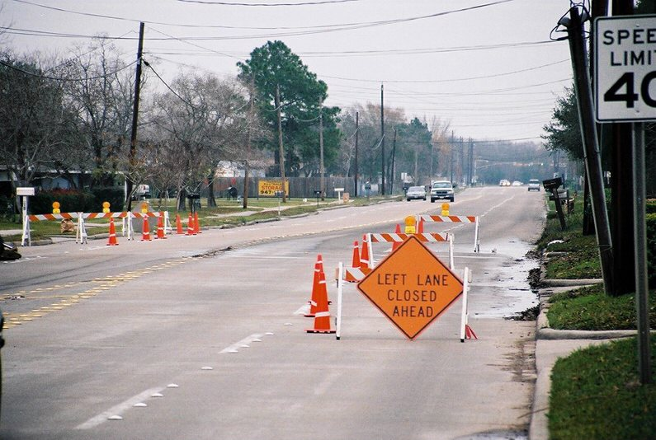
Initial Setup
Drive through
Positive guidance provided for unfamiliar user
Hazards properly delineated
Appropriate sign messages
CMS messages reflect current conditions
Others?

Slide 10
Maintenance of Devices
Routine (Daily) Inspections
During working hours
After work has stopped
Last duty of inspector before leaving the project site – drive through and be sure devices are in proper location
Devices often moved for contractor access during working hours

Slide 11
Maintenance of Devices
Payment for maintenance
Clearly establish basis in contract specifications
Included in pay item
Separate for some items
Surveillance?
Attenuator maintenance?

Slide 12
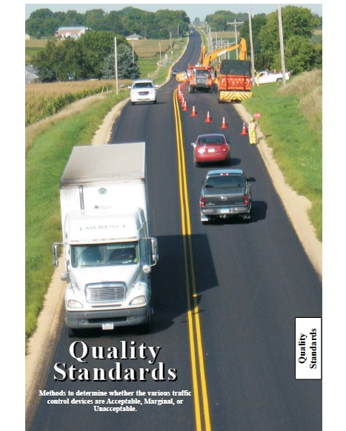
Maintenance of Devices
Subpart K requires adoption of Quality Standards Guide
Training for Inspectors
Quality of devices maintained

Slide 13
QUALITY STANDARDS:
ACCEPTABLE: Devices that meet the quality requirements such as
design, size, color, weight, etc. in the plans and specifications, shall
be considered to be acceptable for use on highway construction
or contract maintenance projects.
MARGINAL: Devices that meet the quality criteria for marginal may
remain in the work zone until their number exceeds the specified
percentage of that type of device or until it is determined that they
have become unacceptable.
UNACCEPTABLE: Devices in the unacceptable category shall not
be delivered to the jobsite. When found in the work zone, they
shall be replaced or repaired within 12 hours of notification or
as contained in the contract specifications.
Notes:
Devices that meet the quality requirements such as design, size, color, weight, etc. in the plans and specifications, shall be considered to be acceptable for use on highway construction or contract maintenance projects.
Devices that meet the quality criteria for marginal may remain in the work zone until their number exceeds the specified percentage of that type of device or until it is determined that they have become unacceptable.
Unacceptable devices shall not be delivered to the jobsite. When found in the work zone, they shall be replaced or repaired within 12 hours of notification or as contained in the contract specifications.

Slide 14
Traffic Operation Implementation
Alternate routes
Strategies to encourage use working?
Operational issues on alternate routes?
Emergency vehicle access to work area or through project
Work Zone ITS
Speed Control Measures
Coordination with other projects in corridor
Queuing

Slide 15
Traffic Operation Implementation
Work zone ITS
Systems installed properly and calibrated to provide accurate information?
PCMS messages legible and accurate?
Dynamic Merge System applied properly?
Loss of credibility of device

Slide 16
Public Information Implementation
Coordination with local media
News releases
Interviews with project personnel
Printed materials distributed
Web site updated
Travel times/delays (if applicable) accurate
Feedback from public

Slide 17
The TMP is implemented. Now what?
Our work is not done
All the effort culminates in one thing:
How does the TMP work in the field?
Are conditions as expected?
Do major issues arise?
Are there many complaints or “bad press”?
Notes:
All the efforts of WZ planning, impacts assessment, coordination, design, TMP development…culminate in one thing:
How does the TMP work in the field?

Slide 18
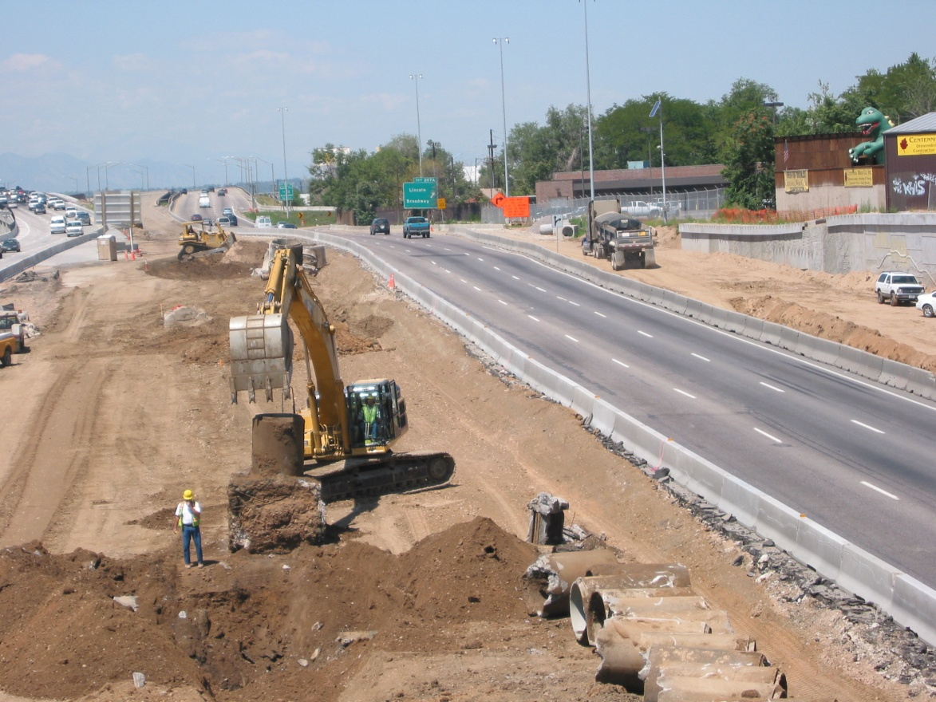
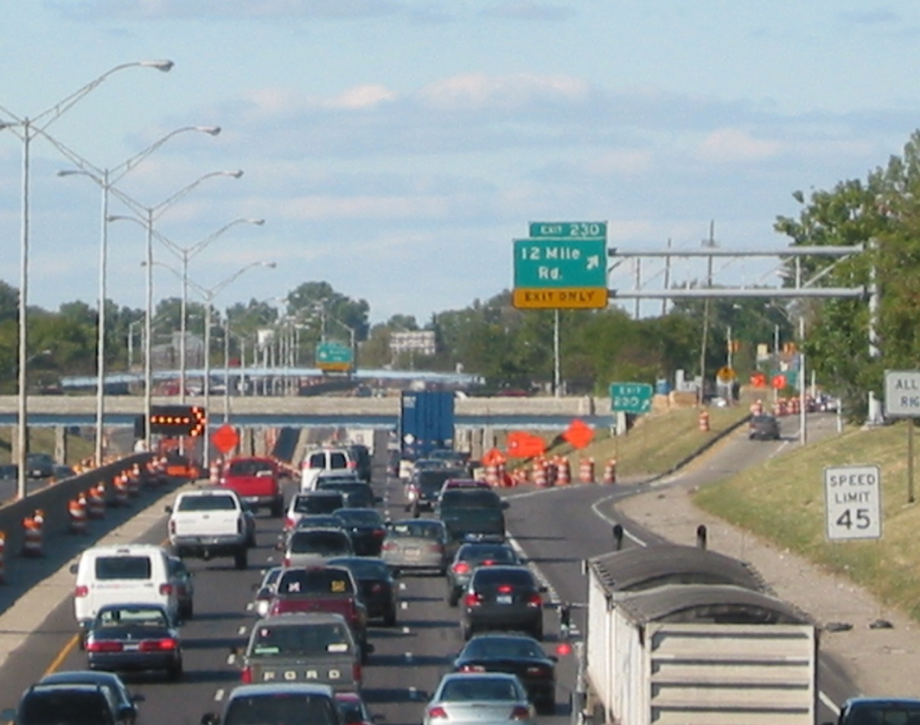
Did I expect this ➔➔➔
But instead got this
⬅⬅⬅
Notes:
These are not made up pictures. I took each of the pictures on this slide and the one a couple slides ago.
Significant work zone back-ups do happen. And extra crashes often come with the back-ups. Realistically, we can’t avoid every back-up or congestion - even with excellent project planning.
But we do need manage them and possibly mitigate them when they happen. And learn what we can to do the most knowledgeable planning we can next time.

Slide 19
How is the TMP working?
Great. No changes are needed.
Poorly.
What went wrong?
Can we fix it?
If not, what can we do?
Ok. Some tweaks might be needed.
What can we learn?

Slide 20
Monitoring TMPs During Construction
Monitoring WZ and TMP performance during construction are important to see if:
Field conditions are similar to predicted impacts used in planning and design
TMP strategies are effective in managing impacts
If performance requirements are not met, what can be changed to improve performance?
DOT and/or contractor should revisit the TMP and consider alternate strategies and/or approach(es)
TMP changes must be approved by the DOT

Slide 21
What to Expect
TMP monitoring is challenging
Tight budgets and staffing constraints
Agencies see importance/worth of monitoring TMPs and do it
Use of monitoring results
Current projects
Assess/adjust work hours
Adjustments to public information, signal timing, other TMP strategies
Improve accuracy of future impacts assessments
Capacity, diversion
Increased effectiveness of future TMPs and designs
Potential savings on future costs

Slide 22
What to Expect
Variety of strategies - simple to complex
Documenting observations from REs
Sampling
Travel time runs, queue monitoring, surveys
Collecting police/crash reports
Deploying mobile trailers with sensors
Using ITS (existing or new)
Using TMCs
Buying data from a 3rd party vendor

Slide 23
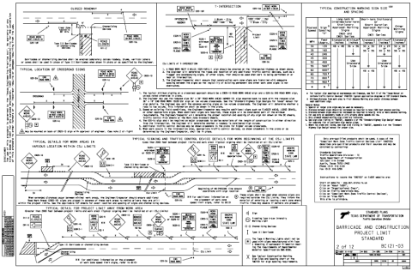
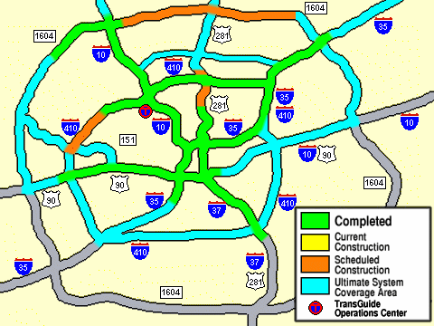
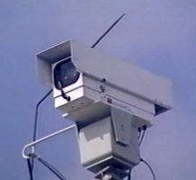
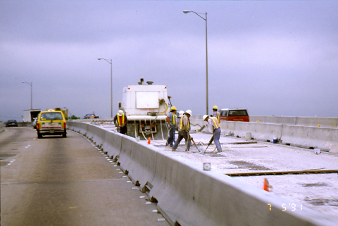
Possible Sources of Data
Project information
Traffic sensor data
Field personnel documentation

Slide 24
Portable Traffic Monitoring Devices
Sensors on trailers or in drums
Easily deployable and movable
Speed or volume data
Easier to collect WZ performance data
Can be used in short duration situations
Can be deployed by a range of personnel

Slide 25
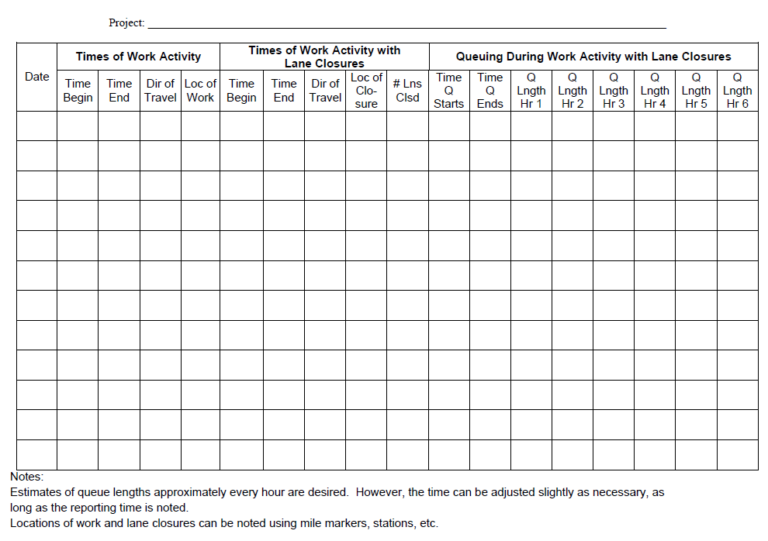
Manual Documentation of Queues

Slide 26
Example TMP Monitoring Policies
Construction staff
Monitor and collect WZ crash data
Identify problematic trends
Implement appropriate adjustments
Monitor queue length for all significant projects
At beginning, middle, and end of each shift for the first week of every phase change (or during daily TCC inspection)
Compare to plans
Project manger submit a quarterly report on:
TO summary
Incident summary
Public comments
Personal observations

Slide 27
RIDOT Monitoring Example
Require construction staff to document all monitoring activities
Made clear during training sessions for construction staff
Occasionally include a line item in contracts requiring contractor to monitor TMP implementation
Developed set of performance monitoring TMP strategies
Include post-construction WZ performance assessment section in their TMP template
Completed by RIDOT TMP Implementation Manager
Document lessons learned
Provide recommendations on how to improve the TMP process and/or modify guidelines
Notes:
RIDOT requires construction staff to document all monitoring activities and has made this clear during training sessions for construction staff. In addition, RIDOT occasionally includes a line item in their contracts requiring the contractor to monitor TMP implementation.
RIDOT has developed a specific set of performance monitoring TMP strategies and includes a post-construction work zone performance assessment section in their TMP template that is to be completed by the RIDOT TMP Implementation Manager upon completion of the work to document lessons learned and provide recommendations on how to improve the TMP process and/or modify guidelines.

Slide 28
What should I measure?
Based on agency goals and objectives
Reflect “realities” of project constraints
Tied to alternatives available and what can be influenced
When work should occur
How much roadway to use
Countermeasure strategies employed
Requires a “suite” of measures

Slide 29
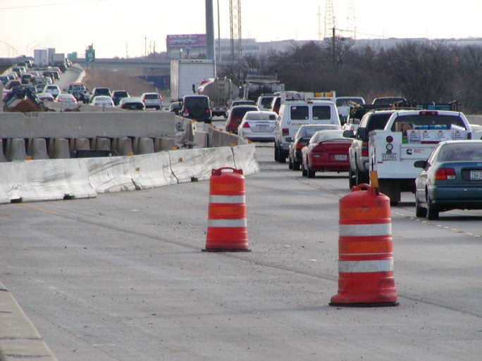
Queue Measures Example
Frequency
Duration
Averages and maximums
% of time queues exceed defined thresholds

Slide 30
Project-Level Performance
Example Measures:
WZ Safety Performance
Traffic crash statistics
Worker fatalities and injuries
Speed/speed variance
WZ Mobility Performance
Delay
Speed
Travel time
Queue length
Exposure
Notes:
Agencies are encouraged to perform project-level performance assessments to improve work zone policies, processes, and procedures and improve their work zone data and information resources. Most of the data needed for this assessment should be available from each project's monitoring efforts including field observations, crash data, and operational data. It is important that traffic and safety monitoring data collected during construction be documented and maintained in a consistent manner for each project. Table 8.4 presents some examples of performance measures that may be considered.
Work Zone Safety Performance. This aspect of work zone performance addresses both traffic and worker safety. Measures are typically obtained over/during a period of time some example are: (refer to slide)
Work Zone Mobility Performance. This aspect of work zone performance provides a representation of the ease, convenience, and efficiency of the transportation system through, in, and around the work zone. Specifically, work zone mobility pertains to moving road users smoothly through or around a work zone area with a minimum delay compared to baseline travel when no work zone is present some examples are: (refer to slide)

Slide 31
Project-Level Performance (cont.)
Example Measures:
Construction Efficiency and Effectiveness
On-time completion
Cost-efficiency/effectiveness
Quality of work
Efforts made to address impacts
Public Perception
Calls/comments received – pro and con
Customer satisfaction indexes
User perceptions about the safety and mobility of the work zone
Notes:
Construction Efficiency and Effectiveness. This aspect of work zone performance provides an assessment of the efficiency and the effectiveness of the actual construction project itself. Even though the efficiency and effectiveness of construction may seem like an unrelated aspect, it is key to the safety and mobility performance of work zones. For example, project delays cause the impacts of the work zones to last longer, and poor quality work require repetitive fixes and repairs at a later stage.
Public Perception. This aspect of work zone performance provides an indication of what the traveling public feels about the performance and impacts of work zones. In spite of the best possible work zone designs and management strategies used, negative public perception about a project may damage the image of a transportation agency, perhaps even resulting in project stoppage. Public perception data can be collected before, during, and after the implementation of road projects. Documentation of public input may yield information that may be useful for implementing work zone designs and strategies that resonate with what the public wants. Public perception data may be collected through surveys (telephone, Internet, roadside), focus groups, and public meetings

Slide 32
What to Consider When TMP Changes are Proposed During Construction
Much has happened prior to now...
Notes:
32
What Should Have Happened Prior:
Project identified as significant or not
Assessment of impacts done
Impacts considered in selection of preferred alternative
TMP developed to reduce and manage the impacts
TMP approved for the project
Some or all of TMP included in PS&Es
Project bid and Award made
All this work and planning has been done, and it can all be thrown away by a bad decision at Construction.

Slide 33
“The benefit of the TMP shines when ODOT can use the document to respond to requests made by contractors to modify the original traffic control plan in some way during construction.
“ODOT can use the information and decisions recorded in the TMP to determine if the integrity of the TCP, promises made to stakeholders, traffic safety and operation can all be maintained if the contractor’s request is implemented.”
–Oregon DOT State Traffic Control Plans Engineer

Slide 34
Changes to a TMP Can...
Affect the MOT decisions made by the DOT during project development
Increase work zone impacts
Queues & delays
Potential for crashes
Reduce the effectiveness of the TMP

Slide 35
If changes are proposed...
How will revised impacts be assessed?
Who will update the impacts assessment?
Are any increased impacts acceptable?
What are the critical issues to address in the TMP? e.g.,
Alternate route availability
Effects on businesses and residents
Changes to lane closures
Who will update the TMP, as needed?
Who will pay for these activities?
Who will pay for any changes in cost to TMP implementation?
Notes:
Findings from recent NRT ARRA project reviews:
1) WZTC was not in accordance with the plans. Major changes to WZTC not documented. Project Manager did not submit WZTC plan changes to the District Traffic Engineer for review and approval per DOT procedures.
Action - FHWA Division will meet with DOT Project Manager to ensure that all plans will be developed by a person trained in the Traffic Operation.
2) Project diaries either did not address WZTC or there were inconsistencies in documentation of WZTC in inspector daily reports and diaries.
Rec - REs should review WZTC at various times including start of project, start of new traffic phases, and periodically during life of project. Reviews should be documented in diaries to help ensure that the WZTC is operating safely and effectively, so that there is documentation that project staff is actively monitoring WZTC.
Action - DOT procedures are that major changes to WZTC will be recorded in project engineer’s log. DOT requires contractor to supply a certified WZTC supervisor for every project. Project engineer is expected to check the TC supervisor's actions.
FHWA Division Engineers will inspect a few projects throughout the State to verify that project engineers are reviewing WZTC at start of the project, start of new traffic phases, and periodically during construction, and that reviews are documented in the daily reports. DOT WZ Safety Office worked with Construction to send out a memo to remind project engineers that major WZTC changes should be documented in the log and that they need to verify at the time of installation that the new TC is in good working order.
3) One State – TTC plan details were missing from local public agency (LPA) PS&E packages.

Slide 36
Responsible Persons
Both DOT and the contractor must designate a responsible person:
At the project-level
Who is appropriately trained
Who has primary responsibility and sufficient authority for implementing the TMP and other safety and mobility aspects of the project
They need to review TMP changes
Notes:
The Responsible Persons designated for the project need to be involved in reviewing any TMP changes that are proposed.
Notice that the responsible persons need to be trained.

Slide 37
Performance Assessment Post-Construction

Slide 38
Objectives Post-Construction
Finish documentation of project results and lessons learned
Review findings
Consider findings in light of findings from other projects
Identify improvements to TMP process and/or modify guidelines/specs for future projects

Slide 39
Document Performance Findings
Summary of the following information:
Observed and/or measured impacts
Compare actual impacts versus the impacts
Effectiveness of TMP and management strategies
Best practices
Innovative approaches/techniques/technologies used
Lessons learned
Recommendations for policy or procedural change
Notes:
This step involves the documentation of the findings of the work zone impacts monitoring process. This documentation should be done throughout the course of the project construction phase. If possible, after the project is complete, this information should be summarized to document:
The observed and/or measured impacts.
A comparison of the actual work zone impacts versus the anticipated work zone impacts of the project.
The effectiveness of the implemented TMP and its constituent management strategies.
Best practices.
Innovative approaches/techniques/technologies used on the project.
Lessons learned and mistakes to avoid.
Any recommendations for policy or procedural change.
Such performance documentation, if performed at the individual project-level, supports the assessment of work zone performance on a large scale (regional/district level, agency-level, State-level, etc.). Information for project-level assessments provides the basis for conducting overall agency work zone performance assessment (discussed in Section 8.0 of this document).

Slide 40
Example Post Construction Conditions/Policies
Report required for each significant project (and others as appropriate) identifying TMP successes and failures
General rating of TMP by field personnel
Revisions required
Comparison of actual conditions to predicted
Cost to implement

Slide 41
Program-Level Assessment
Looking at multiple projects together
Combination of existing/available data sources
Results of impacts assessment and any travel planning and forecasting models
Field observations
Crash records
TMP and TMP evaluation findings
Interviews
Surveys
Notes:
This step represents the synthesis and analysis of performance assessment data and information gathered from the various sources. This data may be aggregated and collated to perform analysis and make recommendations at all levels (e.g. project, program, regional, State and/or national levels.)
Data collection and analysis involve a combination of existing/available sources including (refer to slide)

Slide 42
Project to Program – WI DOT
Collect TMP best practices throughout State
Share these for use on future projects
Statewide review team looks at selection of projects and reports findings on TMP practices annually at conferences and training sessions
Annual meeting to review upcoming projects of next 2 years
Regions share TMP best practices and lessons learned
Discuss how to best coordinate projects
Notes:
Had session in December to look at projects statewide over the next year or two and how to best coordinate them. Reported on findings of TMP and work zone reviews to that group – sharing of best practices. Each region gets an opportunity at this exchange to share best practices from their TMPs.
Also hold TMP Process review meetings in each region, meet with key project staff to discuss 1 or 2 projects in each region. Got an idea from these meetings about effective strategies – off peak work, night work, use of PCMS with real time traffic information, statewide traffic operations center, coordination with adjacent projects, incident management strategies such as freeway service patrols, extra law enforcement on projects. Good public information is key throughout the project – web sites, for major projects use email updates on closure schedules to stakeholder groups, updated maps of closures and detours.

Slide 43
Program Assessment - Process Reviews
Required at least every 2 years
Multi-disciplinary team
In depth review of complete process or specific problem areas
Different than Traffic Control Reviews
Results used to improve processes or procedures
TMPs should be part of review

Slide 44
Feedback Process
Agency implemented policy for the systematic consideration and management of WZ impacts
Policy
Processes and procedures to implement and sustain WZ policy
Process
Project-Level Procedures to Assess and Manage Impacts on Individual Projects
Project

Slide 45
Feedback Process
Areas of concern
Project specific?
Provide information back to designers for future consideration
Across the District?
Statewide?
Revise standards and/or specifications
Revise WZ Policy
Share best practices/lessons learned
Add to training

Slide 46
Performance Assessment Recap
Identify measures
Record observations and collect data
Synthesize and analyze data at multiple levels
Apply analysis results

Slide 47
Why Assess TMP Performance?
Opportunity to learn
Know how TMPs are working and what to improve
Identify and share best practices
Support decisionmaking

